Slide 1






2022-23 Federal Longitudinal Graduation Rates
A-1
February 13, 2024

Slide 2
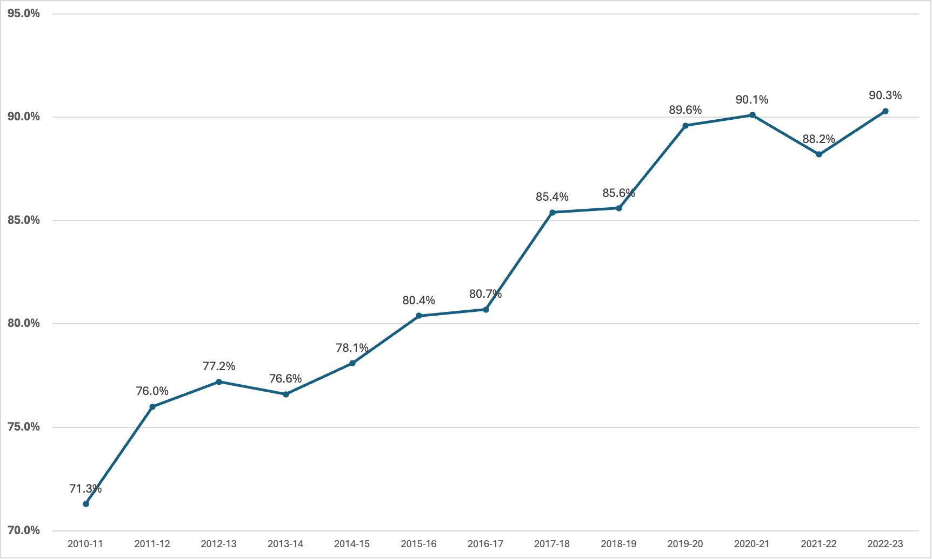
Miami-Dade County Public Schools
Federal Longitudinal Graduation Rates
2010-11 through 2022-23

Slide 3
Miami-Dade County Public Schools
Federal Longitudinal Graduation Rates
2021-22 & 2022-23 Cohorts
Compared to Florida, 2023
Subgroup | M-DCPS 2021-22 | M-DCPS 2022-23 | M-DCPS Difference | Florida 2022-23
Overall | 88.2 | 90.3 | 2.1 | 88.0
Hispanic | 88.9 | 90.9 | 2.0 | 86.8
White | 94.5 | 93.8 | -0.7 | 91.0
Black | 82.4 | 86.4 | 4.0 | 83.2
SWD | 86.0 | 88.1 | 2.1 | 85.5
ED | 86.6 | 89.3 | 2.7 | 83.8
ELL | 75.1 | 80.1 | 5.0 | 76.1

Slide 4
Miami-Dade County Public Schools
Federal Longitudinal Graduation Rates
2018-19 through 2022-23 Cohorts
Compared to Florida and Large Districts
County | 2018-19 | 2019-20* | 2020-21* | 2021-22 | 2022-23 | Difference
Miami-Dade | 85.6 | 89.6 | 90.1 | 88.2 | 90.3 | 2.1
FLORIDA | 86.9 | 90.0 | 90.1 | 87.3 | 88.0 | 0.7
Broward | 86.2 | 89.4 | 89.1 | 87.2 | 88.7 | 1.5
Duval | 86.5 | 90.2 | 89.6 | 85.6 | 87.2 | 1.6
Hillsborough | 86.2 | 88.8 | 89.2 | 87.9 | 86.2 | -1.7
Orange | 88.4 | 90.4 | 90.4 | 87.0 | 89.1 | 2.1
Palm Beach | 87.1 | 90.2 | 91.0 | 89.0 | 90.5 | 1.5
*FLDOE provided flexibility for graduation requirements | *FLDOE provided flexibility for graduation requirements | *FLDOE provided flexibility for graduation requirements | *FLDOE provided flexibility for graduation requirements | *FLDOE provided flexibility for graduation requirements | *FLDOE provided flexibility for graduation requirements | *FLDOE provided flexibility for graduation requirements

Slide 5



Key Takeaways
90.3%
19
94.2%
M-DCPS achieved its highest graduation rate to date, showcasing remarkable progress and success.
The District's federal longitudinal rate has shown an impressive increase of 19 percentage points since its initial report in 2010-11, rising from 71.3% to its current level.
When considering only traditional schools, M-DCPS boasts an exceptional graduation rate of 94.2%.

Slide 6






2023 AP CSP
FEMALE DIVERSITY AWARD
Arthur & Polly Mays 6-12 Grade Conservatory of the Arts
Design and Architecture Senior High School
Felix Varela Senior High School
Medical Academy for Science and Technology
Miami Jackson Senior High School
Miami Norland Senior High School
Miami Springs Senior High School
Young Women's Preparatory Academy
CONGRATULATIONS TO M-DCPS WINNERS!

