Slide 1





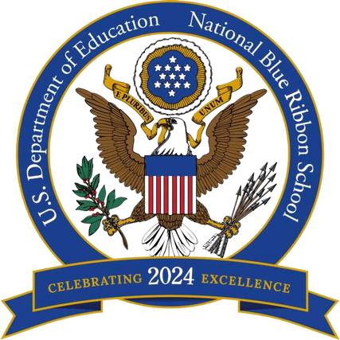

CONGRATULATIONS TO M-DCPS
2024 NATIONAL BLUE RIBBON SCHOOLS
GEORGE WASHINGTON CARVER MIDDLE SCHOOL
PRINCIPAL ILIANA ARTIME
JOSE MARTI MAST 6-12 ACADEMY
PRINCIPAL JOSE ENRIQUEZ, JR.
NORTH DADE CENTER FOR MODERN LANGUAGES
PRINCIPAL LATOYA JAMES-EDWARDS

