Slide 1

SCHOOL BOARD CONFERENCE SESSION
ATTENDANCE ZONE RECOMMENDATIONS
2025-2026
WEDNESDAY, APRIL 16, 2025

Slide 2

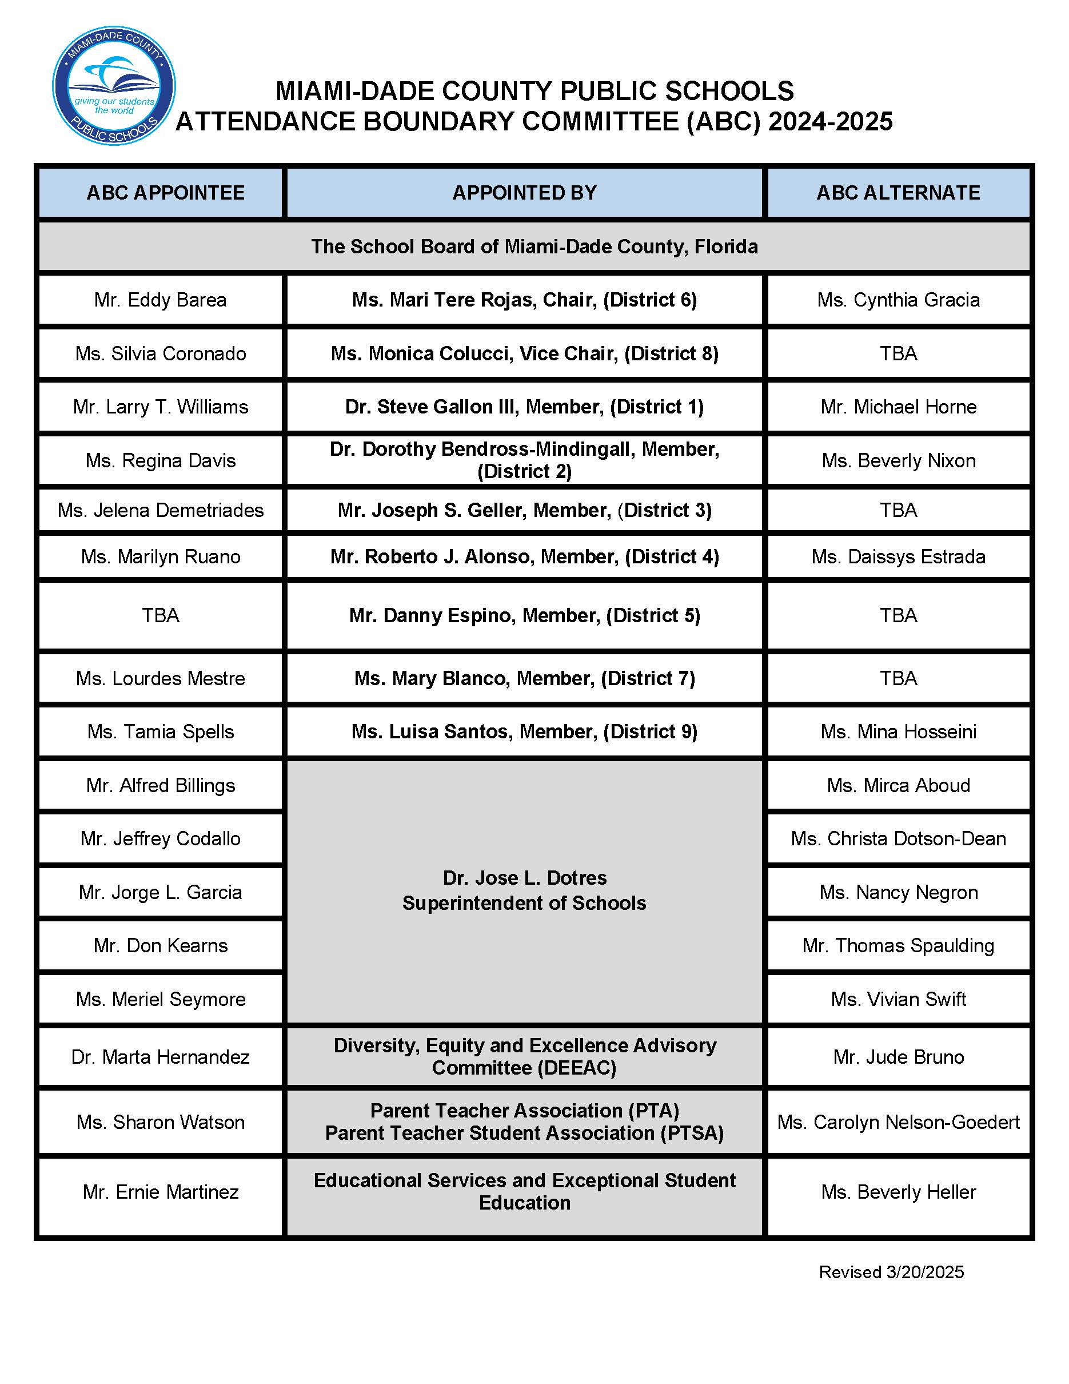

Slide 3
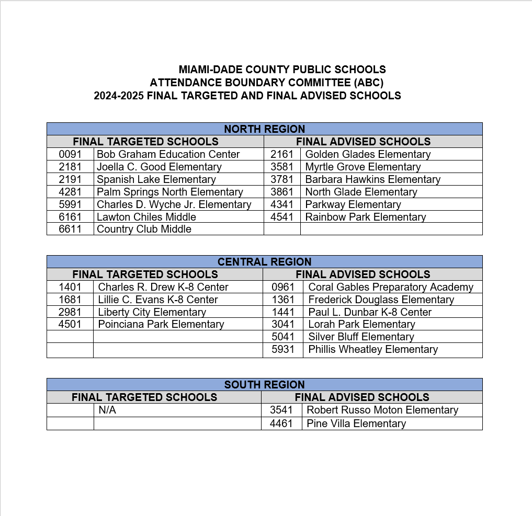

Slide 4
Attendance Boundary Committee (ABC) Timeline at a Glance
Thursday, October 24, 2024 | Orientation meeting for ABC members
Thursday, November 14, 2024 | Presentation of initially targeted/advised school recommendations to ABC
Friday, November 15, 2024 | Principals of initially targeted/advised schools were notified, and communications were sent to parents
Thursday, December 5, 2024 | ABC identified final targeted/advised schools
Friday, December 6, 2024 | Principals of final targeted/advised schools were notified
Wednesday, December 11, 2024 | Regions submit community meeting dates
January 6, 2025 – January 24, 2025 | Community Meetings were conducted for Targeted and Advised schools.
Friday, February 7, 2025 | ABC reviewed recommendations submitted by community/Region Offices and approved the final targeted and advised schools
Thursday, March 13, 2025 | ABC boundary recommendations were presented at the Diversity, Equity, and Excellence Advisory Committee (DEEAC) meeting
Tuesday, April 1, 2025 | Region Superintendents present recommendations approved by the ABC to Superintendent of Schools, School Board Attorney and appropriate staff.
Wednesday, April 16, 2025 | School Board Conference Session and Initial Reading for Attendance Zones 2025-2026
Wednesday, June 18, 2025 | School Board Meeting - Final Reading Attendance Zones for 2025-2026

Slide 5
Attendance Boundary Committee (ABC) Factors Considered
Declining enrollment and ability to conduct a viable educational program
Compliance with Class Size Reduction Mandate
Impact on Exceptional Student Education programs
Use of available student stations within contiguous areas
Degree and extent of transportation
Programmatic impact due to lack of student housing
Reduction of the number of schools students must attend
Integrity of feeder systems
Assignment of students from new residential developments to specific schools prior to completion of developments
Construction of new schools
Promotion and maintenance of diverse school enrollments
Reduction or elimination of racial isolation to the extent practical

Slide 6
Student Demographics Factors
White
Black
Hispanic
Asian/Pacific Islander
Multiracial
Exceptional Student Education Programs
Free/Reduced Price Lunch
English Language Learners
Male
Female

Slide 7
South Region Office Advised Status Only
Robert Russo Moton Elementary School
Pine Villa Elementary School

Slide 8
Questions/ Comments
?

Slide 9
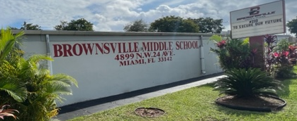

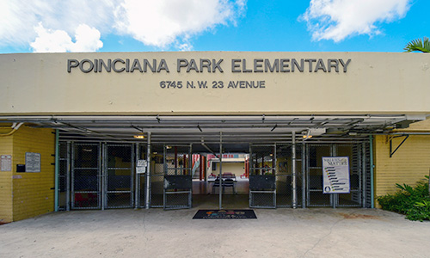
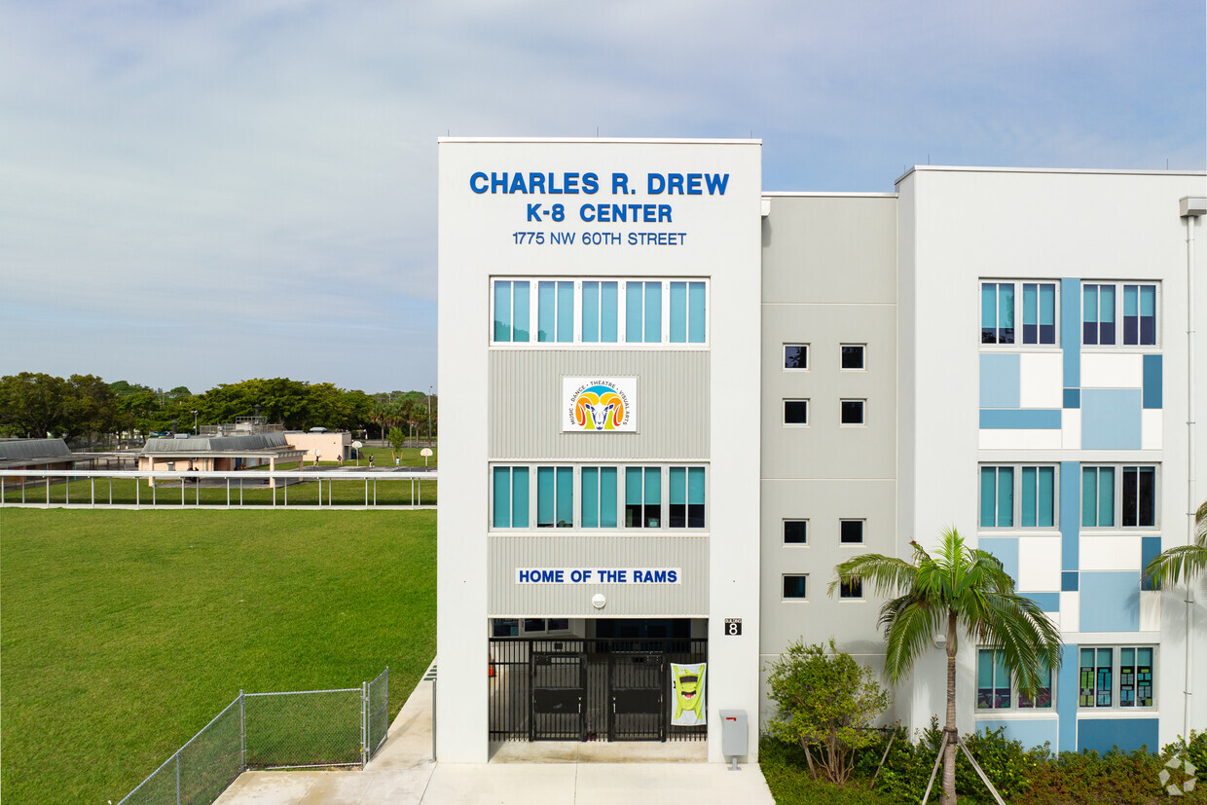
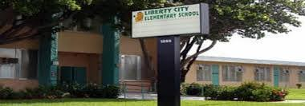
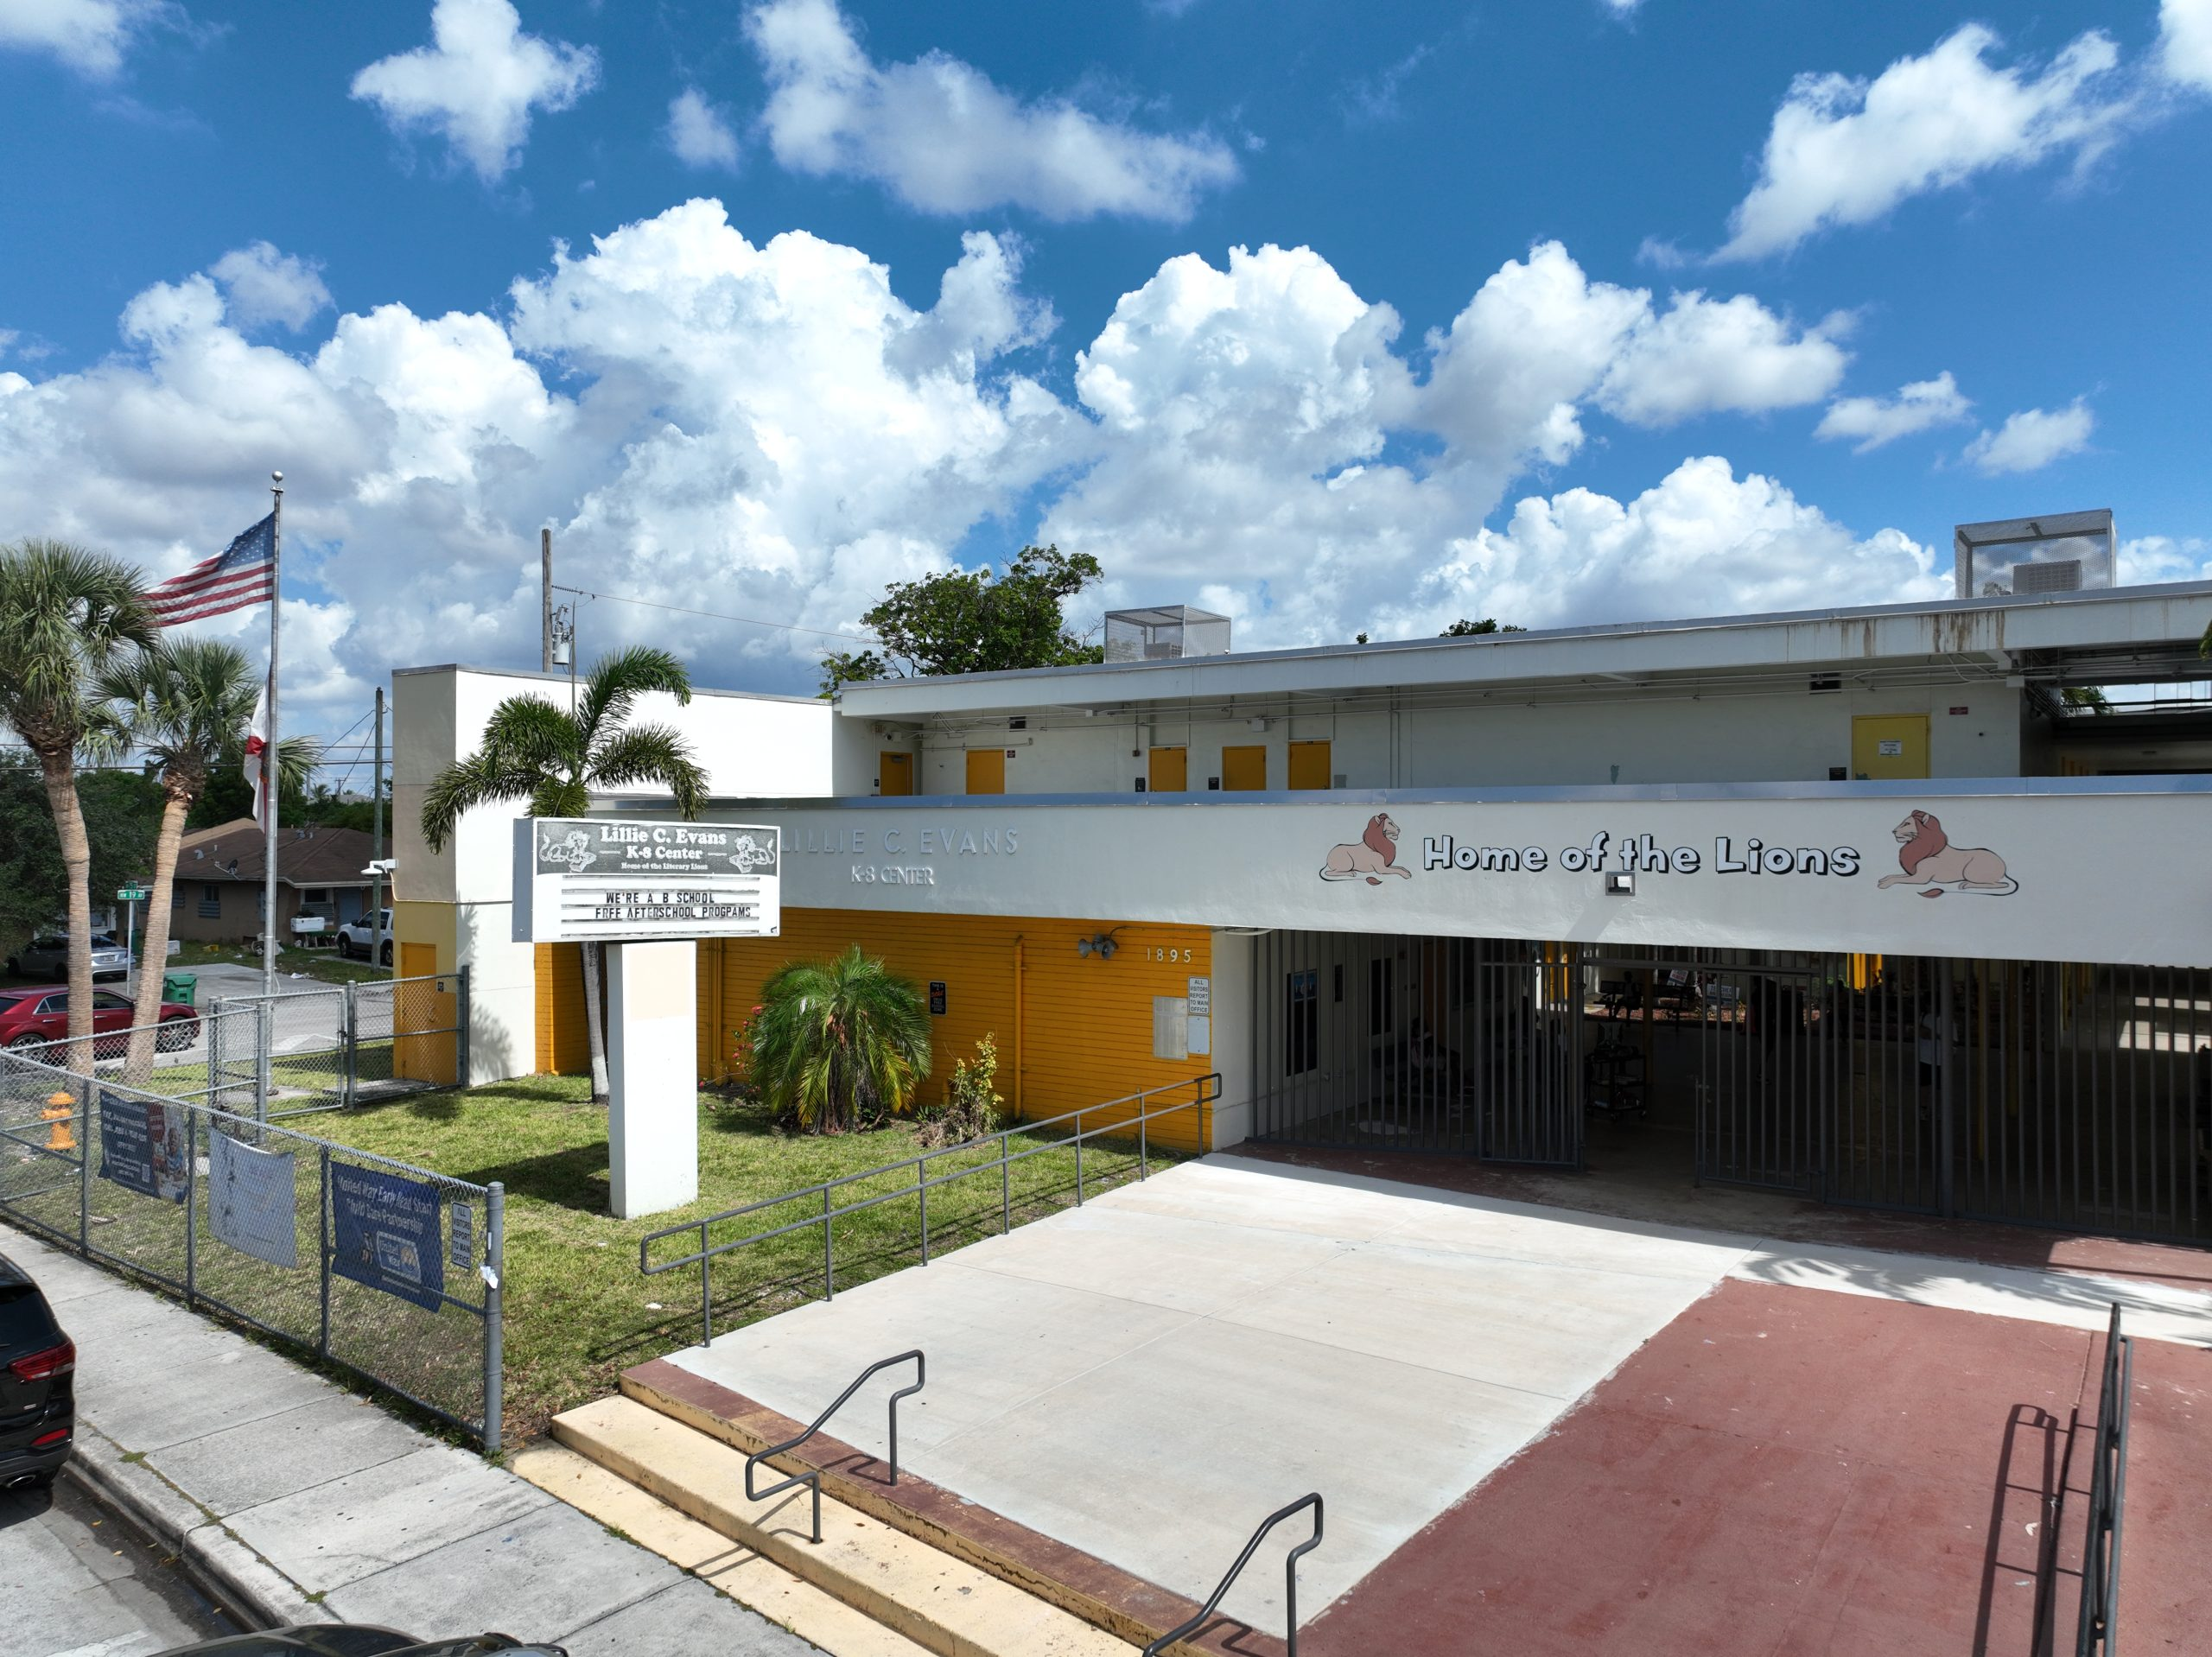
Proposed ABC Recommendations
Poinciana Park Elementary Charles Drew K-8 Center
Lillie C. Evans K-8 Center Liberty City Elementary
Brenda Swain
Region Superintendent
Manuel Garcia
ABC Region Director

Slide 10
Recommendations
Proposed recommendations for Poinciana Park Elementary School, Charles Drew K-8 Center, Liberty City Elementary School, and Lillie C. Evans K-8 Center.
Consider a plan to repurpose Poinciana Park Elementary
Combine a portion of the current boundary of Poinciana Park Elementary School (Area A) to be combined with the current boundary of Lillie C. Evans K-8 Center.
Combine a portion of the current boundary of Poinciana Park Elementary School (Area B) to be combined with the current boundary of Liberty City Elementary School.
Combine a portion of the current boundary of Poinciana Park Elementary School (Area C) to be combined with the current boundary of Charles Drew K-8 Center.
Brownsville will remain as the traditional Middle School.

Slide 11
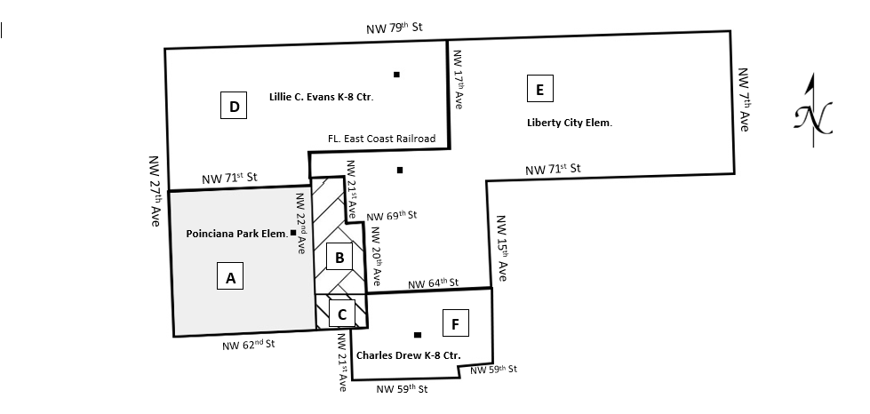
Recommendations
 | Areas A, B, and C represent the current boundary assigned to Poinciana Elementary School.
 | Proposed new boundary for Lillie C. Evans K-8 Center, currently assigned to Poinciana Park Elementary with Brownsville Middle School remaining as the traditional Middle School.
 | Proposed new boundary for Liberty City Elementary School, currently assigned to Poinciana Park Elementary with Brownsville Middle School remaining as the traditional Middle School.
 | Proposed new boundary for Charles Drew K-8 Center, currently assigned to Poinciana Park Elementary with Brownsville Middle School remaining as the traditional Middle School.
A
B
C
A
D
B
E
C
F

Slide 12
Current boundary for
Poinciana Park Elementary
Begin at NW 27th Avenue and NW 71st Street
East to NW 21st Avenue
South to NW 69th Street
East to NW 20th Avenue
South to NW 62nd Street
West to NW 27th Avenue
North to NW 71st Street
point of beginning.

Slide 13
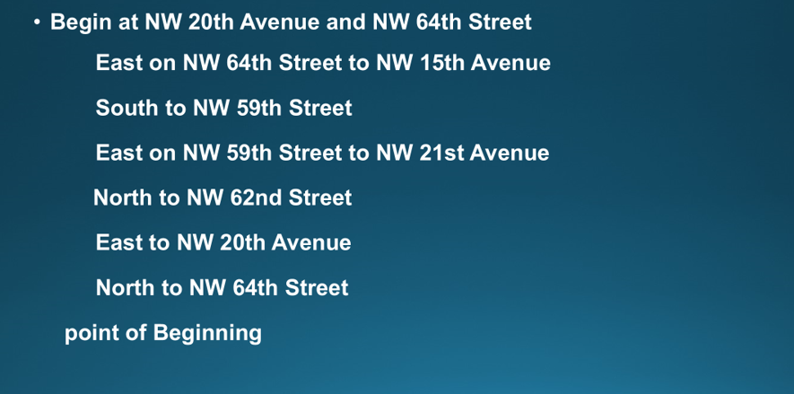
Current boundary for
Charles R. Drew K-8 Center

Slide 14
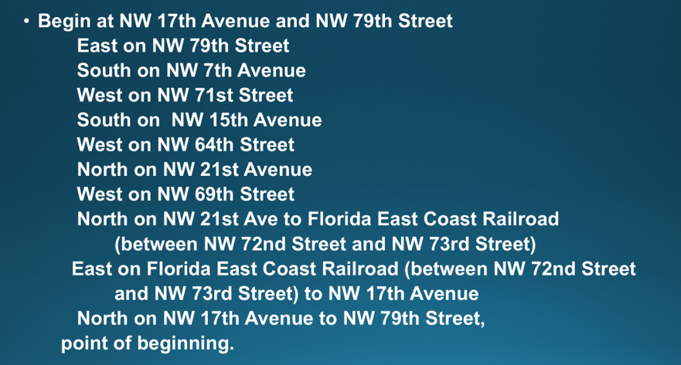
Current boundary for
Liberty City Elementary

Slide 15
Current boundary for Lillie C. Evans K- 8 Center
Begin at NW 79th Street and NW 27th Avenue
East to NW 17th Avenue
South to Florida East Coast Railroad (between NW 72nd Street
and NW 73rd Street)
West to NW 22nd Avenue
South to NW 71st Street
West to NW 27th Avenue
North to NW 79th Street,
Point of beginning.

Slide 16
Proposed boundary for Charles Drew K-8 Center
Begin at NW 22nd Avenue and NW 64th Street
East to NW 15th Avenue
South to NW 59th Street
West to NW 21st Avenue
North to NW 62nd Street
West to NW 22nd Avenue
North to NW 64th Street
Point of beginning.

Slide 17
Proposed boundary for Liberty City Elementary
Begin at NW 17th Avenue and NW 79th Street
East on 79th Street
South on NW 7th Avenue
West on NW 71st Street
South on NW 15th Avenue
West to NW 64th Street
North on 22nd Avenue to FL. East Coast Railroad
East on FL. East Coast Railroad
North on NW 17th Avenue to 79th Street
Point of beginning.

Slide 18
Proposed boundary for Lillie C. Evans K-8 Center
Begin at NW 79th Street and NW 27th Avenue
East to NW 17th Avenue
South to Florida East Coast Railroad (between NW 72nd Street and NW 73rd Street)
West to NW 22nd Avenue
South to NW 62nd Street
West to NW 27th Avenue
North to NW 79th Street
Point of beginning.

Slide 19
Effects
Beginning with the 2025-2026 School Year:
New boundaries will be established for Charles Drew K-8 Center, Liberty City Elementary School, and Lillie C. Evans K-8 Center.
In Area (A), forty-four (44) kindergarten through fourth grade students residing in the boundary of Poinciana Park Elementary will be assigned to Lillie C. Evans K-8 Center.
In Area (B), thirty-six (36) kindergarten through fourth grade students residing in the boundary of Poinciana Park Elementary will be assigned to Liberty City Elementary School.
In Area (C), twenty-four (24) kindergarten through fourth grade students residing in the boundary of Poinciana Park Elementary will be assigned to Charles Drew K-8 Center.
All kindergarten through fourth grade students residing in the combined boundaries of Poinciana Park Elementary, Charles Drew K-8 Center, Liberty City Elementary School, and Lillie C. Evans K-8 Center will attend Brownsville Middle School as their traditional Middle School.

Slide 20
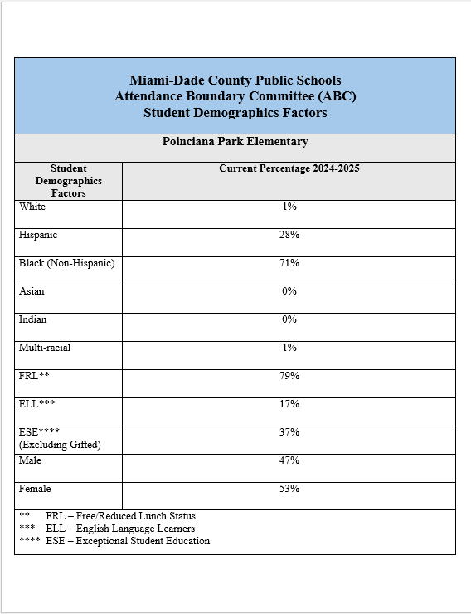

Slide 21
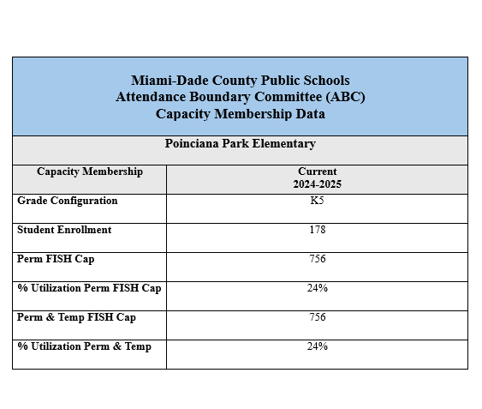

Slide 22
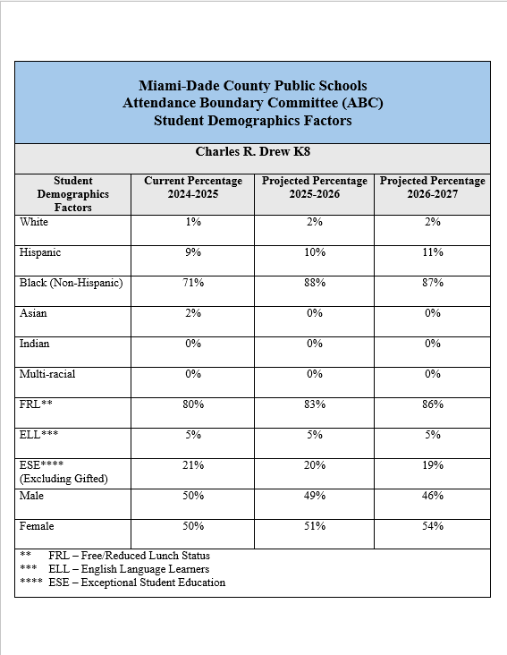

Slide 23
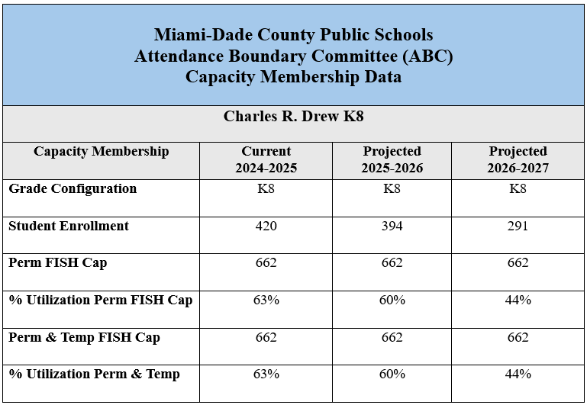

Slide 24
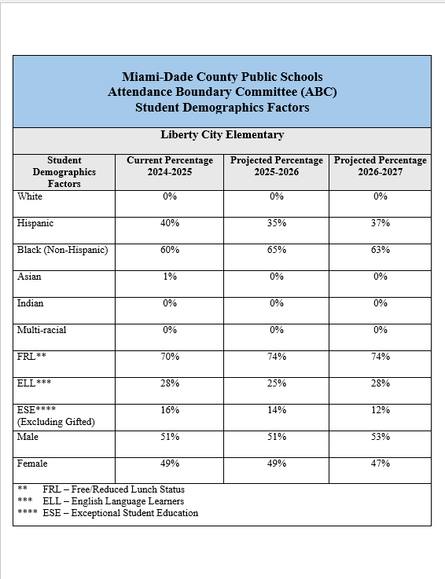

Slide 25


Slide 26
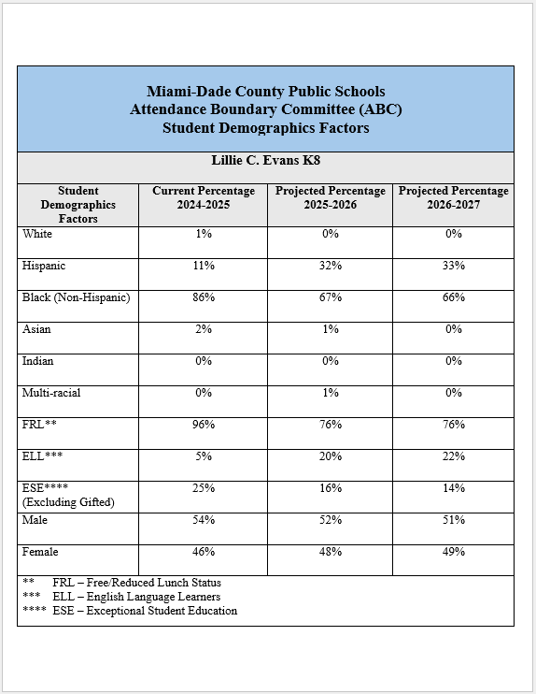

Slide 27
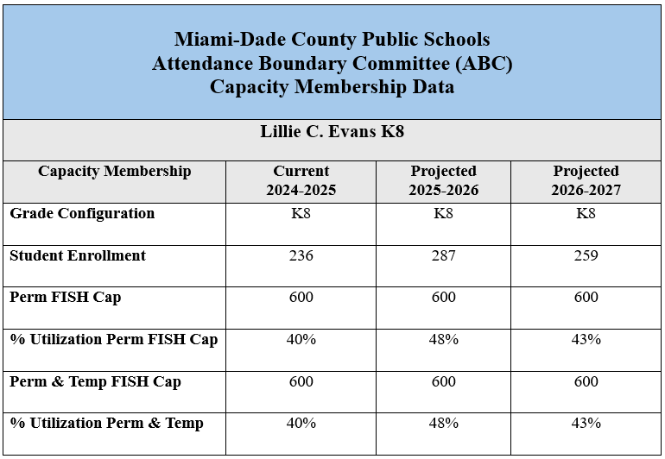

Slide 28
Questions/ Comments
?

Slide 29
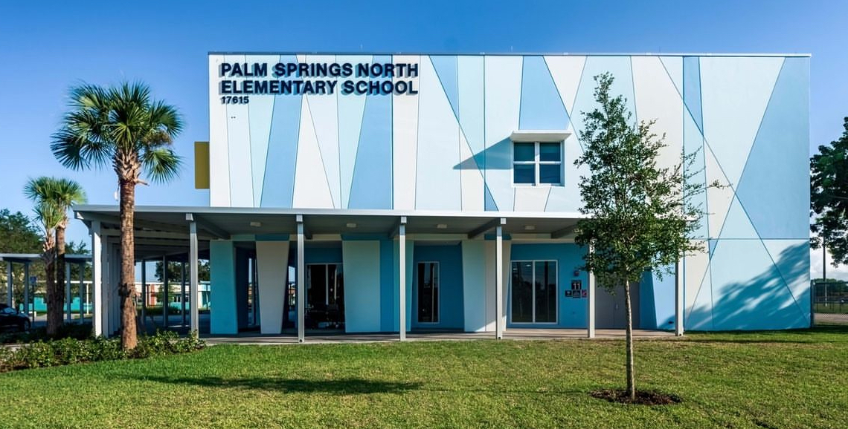

Proposed ABC Recommendations
Palm Springs North
Elementary School
Dr. Yesenia M. Aponte
Region Superintendent
Mr. Leonard Torres
ABC Region Director

Slide 30
Recommendations
Convert Palm Springs North Elementary to a full K-8 Center in response to parent interest and a community assessment.

Slide 31
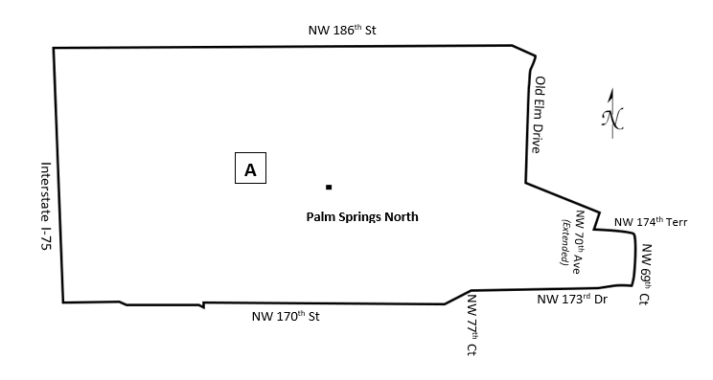
Recommendations
 | The current boundary for Palm Springs North Elementary will remain the same.
A

Slide 32
Current boundary for
Palm Springs North Elementary
Begin at NW 186 Street (Miami Gardens Drive) and Old Elm Drive
Southeast through center of golf course (Former Country Club of Miami South Course) to intersection of NW 174 Terrace and NW 70 Avenue (extended)
East on NW 174 Terrace to NW 69 Court
South to NW 173 Drive
West to NW 77 Court
South to NW 170 Street
West to Interstate 75 (approximately NW 92 Avenue)
North to NW 186 Street (Miami Gardens Drive)
East to Old Elm Drive
point of beginning.

Slide 33
Effects
Beginning with the 2025-2026 School Year
Palm Springs North will gradually include a full complement of grades.

Slide 34
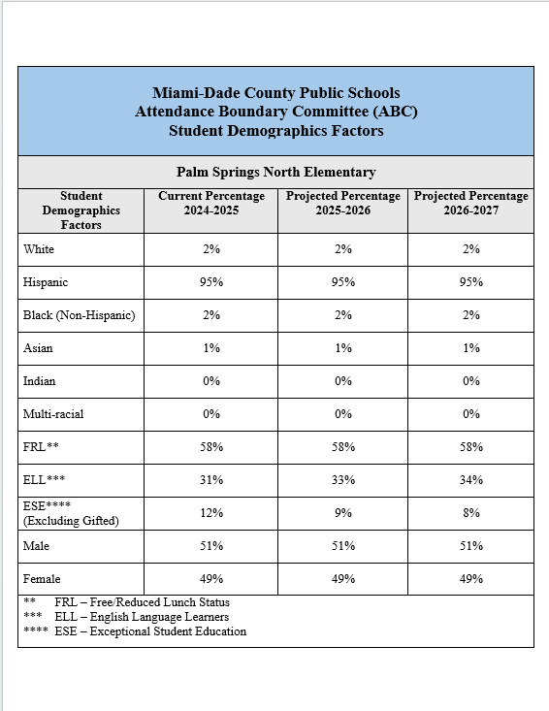

Slide 35
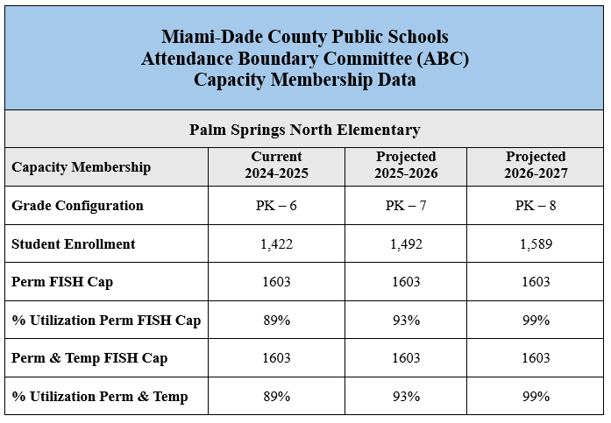

Slide 36
Questions/ Comments
?

Slide 37
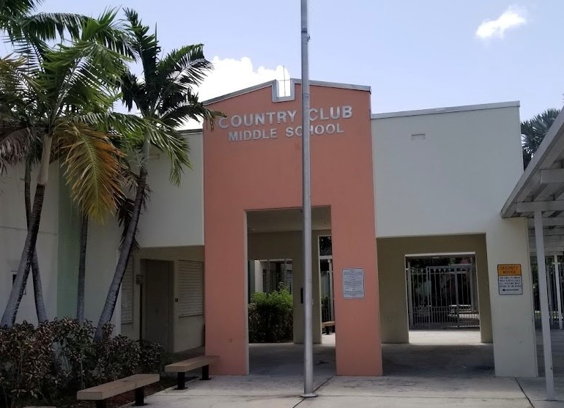
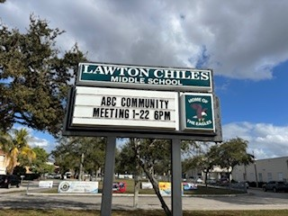
Proposed ABC Recommendations
Country Club Middle School
Lawton Chiles Middle School
Dr. Yesenia M. Aponte
Region Superintendent
Mr. Leonard Torres
ABC Region Director

Slide 38
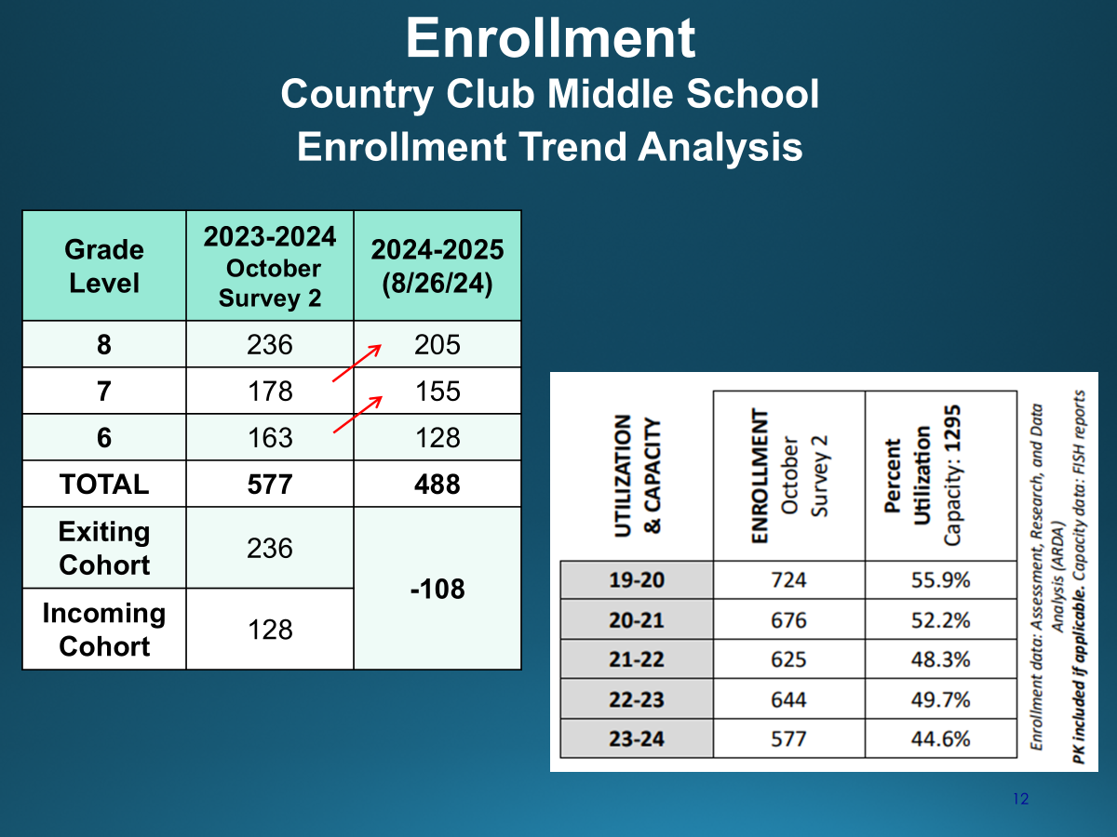
Proposed Attendance Boundary Recommendations Community Meeting January 16 & 22, 2025
Country Club Middle School
Lawton Chiles Middle School
Dr. Yesenia M. Aponte
Region Superintendent
Mr. Leonard Torres
ABC Region Director

Slide 39
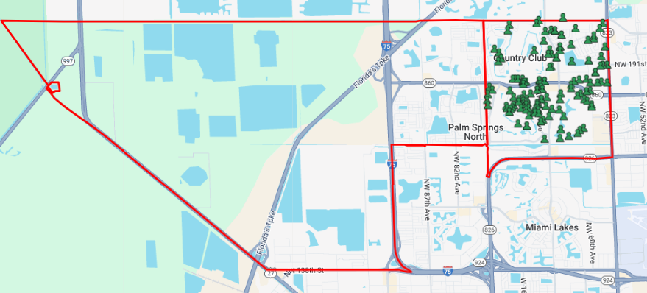
Rationale for Boundary Change
Country Club Middle School area students currently attending Lawton Chiles Middle School

Slide 40
Recommendations
Dissolve the current boundary for Country Club Middle School
Combine the boundaries of Lawton Chiles Middle School and Country Club Middle School
Establish new boundaries for Lawton Chiles Middle School

Slide 41
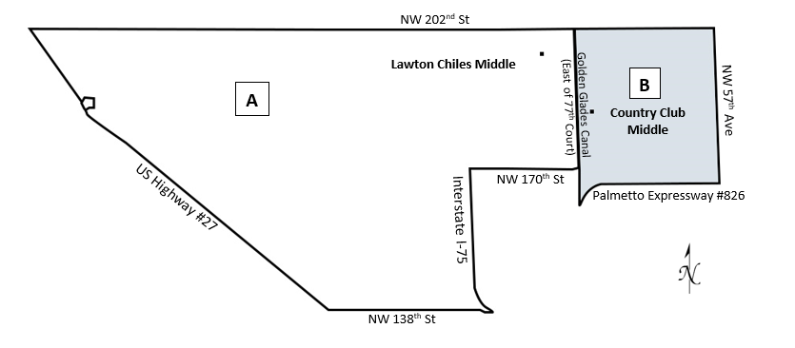
Recommendations
 | Area A represents the current boundary for Lawton Chiles Middle.
 | Area B represents the current boundary for Country Club Middle.
 | Areas A and B represent the proposed new boundary for Lawton Chiles Middle.
A
B
AB

Slide 42
Current boundary for
Lawton Chiles Middle School
Begin at NW 202 Street (Miami Dade/Broward County Line) and US Highway 27 (Okeechobee Road)
East on NW 202 Street (Miami Dade/Broward County Line) to Golden Glades Canal (East of NW 77 Court)
South on Golden Glades Canal (East of NW 77 Court) to 170 Street
West on NW 170 Street to Interstate 75 (I-75)
South along Interstate 75 (I-75) to NW 138 Street
West on NW 138 Street to US Highway 27 (Okeechobee Road)
North on US 27 (Okeechobee Road) to NW 202 Street (Miami-Dade/Broward County Line)
point of beginning.

Slide 43
Current boundary for
Country Club Middle School
Begin at NW 202 Street (Miami-Dade/Broward County Line) and Golden Glades Canal (East of NW 77 Avenue)
East to NW 57 Avenue
South to Palmetto Expressway (#826)
West to Golden Glades Canal (East of NW 77 Avenue)
North to NW 202 Street (Miami-Dade/Broward County Line)
point of beginning.

Slide 44
Proposed boundary for Lawton Chiles Middle School
Begin at NW 202 Street (Miami Dade/Broward County Line) and US Highway 27 (Okeechobee Road)
East on NW 202 Street (Miami Dade/Broward County Line) to NW 57 Avenue
South to Palmetto Expressway (#826)
West to Golden Glades Canal (East of NW 77 Avenue)
North to NW 170 Street
West on NW 170 Street to Interstate 75 (I-75)
South along Interstate 75 (I-75) to NW 138 Street
West on NW 138 Street to US Highway 27 (Okeechobee Road)
North on US 27 (Okeechobee Road) to NW 202 Street (Miami-Dade/Broward County Line)
point of beginning.

Slide 45
Proposed boundary for Lawton Chiles Middle School
Begin at NW 202 Street (Miami Dade/Broward County Line) and US Highway 27 (Okeechobee Road)
East on NW 202 Street (Miami Dade/Broward County Line) to NW 57 Avenue
South to Palmetto Expressway (#826)
West to Golden Glades Canal (East of NW 77 Avenue)
North to NW 170 Street
West on NW 170 Street to Interstate 75 (I-75)
South along Interstate 75 (I-75) to NW 138 Street
West on NW 138 Street to US Highway 27 (Okeechobee Road)
North on US 27 (Okeechobee Road) to NW 202 Street (Miami-Dade/Broward County Line)
point of beginning.

Slide 46
Effects
Beginning with the 2025-2026 School Year
New boundaries will be established for Lawton Chiles Middle School to include the Country Club Middle School boundary (Area B).
All 6th – 8th grade students residing in Area B will be assigned to Lawton Chiles Middle School.

Slide 47
Effects
Approximately 188 rising 7th and 8th grade students currently attending Country Club Middle School and residing in Area B will be assigned to Lawton Chiles Middle School.
Approximately 251 rising 6th-grade students from elementary schools residing in Area B will be assigned to Lawton Chiles Middle School.
Data trends reflect that only 25% of rising 6th graders living within the boundary choose to attend Country Club Middle.

Slide 48
Effects
Approximately 127 rising 6th grade students attending K-8 Centers, and residing in Area B, may remain at the K-8 Center or select Lawton Chiles Middle School as a traditional middle school option.
Bob Graham K-8 Center
Palm Springs North (Proposed K-8 Center)
District enrollment trends have shown that students from a K-8 setting tend to remain at the K-8 location for middle grades. Therefore, the anticipated impact on these students is minimal.
High School boundaries will remain the same.

Slide 49
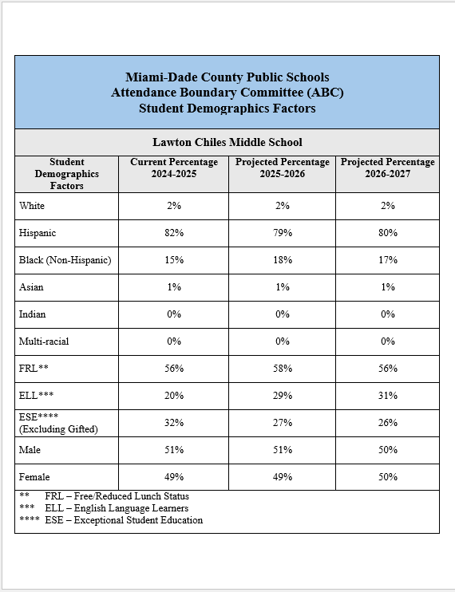

Slide 50
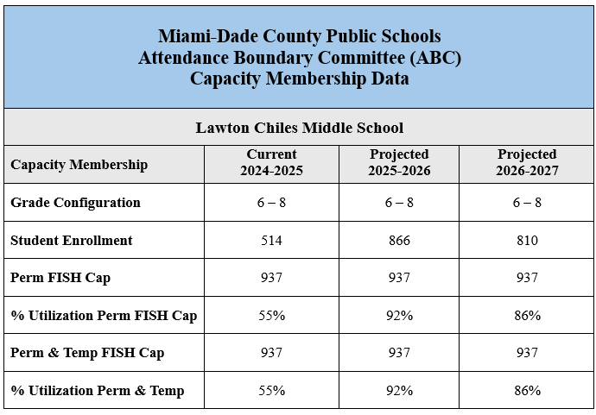

Slide 51
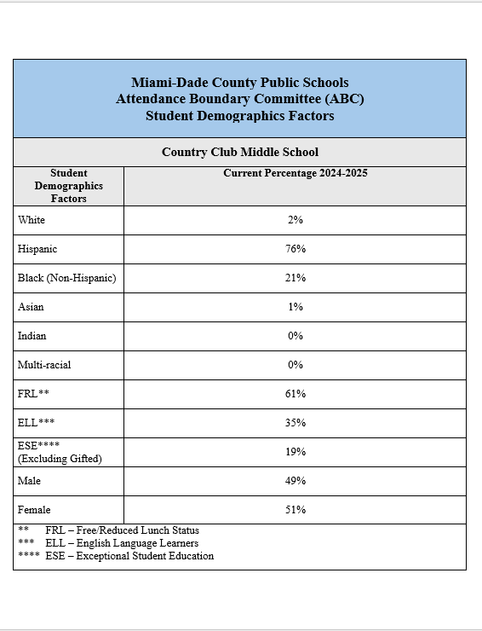

Slide 52
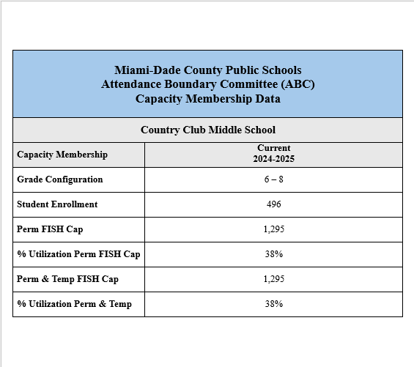

Slide 53
Questions/ Comments
?

Slide 55

SCHOOL LEADERSHIP & PERFORMANCE ATTENDANCE BOUNDARY COMMITTEE

