Slide 1


MIAMI-DADE COUNTY PUBLIC SCHOOLS
Office of Postsecondary Career & Technical Education
Expanding CTE Dual Enrollment for High School Students
Through M-DCPS Technical Colleges
Presented by Mr. René Mantilla, Assistant Superintendent

Slide 2

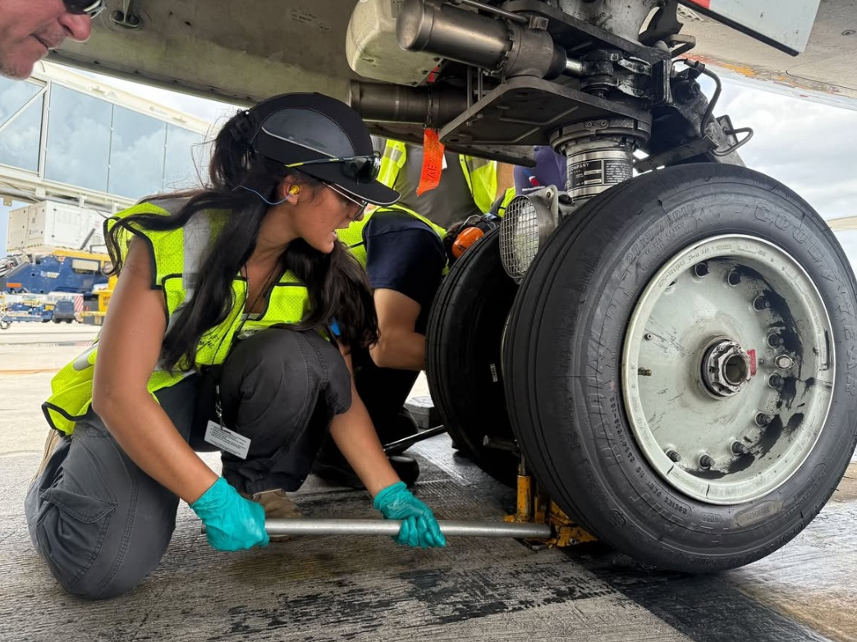
MIAMI-DADE COUNTY PUBLIC SCHOOLS | OPCTE
WHY EXPAND CAREER DUAL ENROLLMENT PROGRAMS?
KEY BENEFITS
Accelerated Career Pathways
Students can graduate high school having earned a high school diploma and an industry certification, reducing the time and cost required to enter the workforce or complete a degree. This head start allows them to begin their professional lives sooner and with no debt.
Enhanced Employability
The programs focus on high-demand, high-wage fields, ensuring that the skills students learn are directly applicable to the current job market. This makes them more competitive and better prepared for today's economy.
Increased Access
These programs offer a tuition-free pathway to a postsecondary credential. This breaks down financial barriers to accessing higher education and skilled careers.
Aviation Mechanics Career Dual Enrollment Student: George T. Baker Aviation Technical College

Slide 3
MIAMI-DADE COUNTY PUBLIC SCHOOLS | OPCTE
CAREER DUAL ENROLLMENT EXPANSION
Annual Median Salary in Miami ($47,920)*
High School | Career Dual Enrollment Program | Annual Median Salary (Bureau of Labor Statistics Florida 2024) | Projected Student Enrollment | Industry Certification
Hialeah Senior High School | Master Automotive Service Technology | $48,520 | 80 | Automotive Service Excellence (ASE) -8 Stackable Credentials (e.g. Brake System Technician, Engine Repair Technician, etc.)
Miami Carol City Senior High | Medical Assisting | $44,520 | 65 | Certified Medical Assistant Certified EKG Technician Certified Phlebotomy Technician
Miami Northwestern Senior High | Dental Assisting | $45,520 | 90 | Certified Dental Assistant
Miami Springs Senior High School | Avionics Systems Technician Medical Assisting | $82,850 $44,520 | 25 100 | Aircraft Electronics Technician Certified Medical Assistant
George T. Baker Aviation Technical College Extension Campus @ Miami Sunset Senior High School | Aviation Powerplant Mechanics | $79,130 | 110 | Aviation Maintenance Technician General
*Source: U.S. Bureau of Labor Statistics – Area: Miami Period: May 2024 Median Household Income

Slide 4
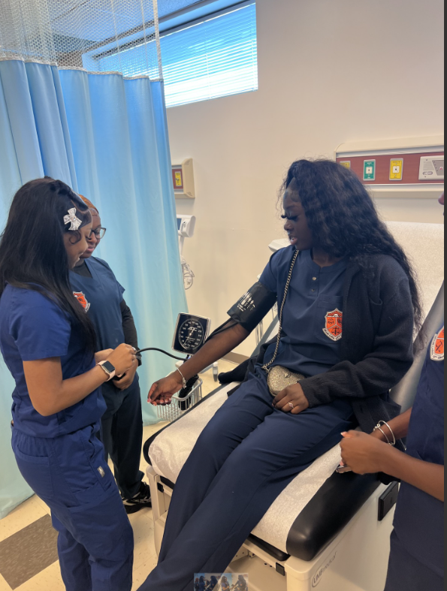
MIAMI-DADE COUNTY PUBLIC SCHOOLS | OPCTE
COST BENEFITS OF CAREER DUAL ENROLLMENT EXPANSION
Strategic Funding Sources:
Expansions were funded through competitive grants and industry performance allocation, tied to successful student outcomes and program completion.
Significant Transportation Savings:
The elimination of student travel to the technical college campuses results in direct savings on fuel, bus maintenance, and driver labor costs.
Increased Scheduling Flexibility:
Removing the need for travel time drastically reduces master schedule constraints.
Medical Assisting Career Dual Enrollment Students:
Miami Carol City Senior High School

Slide 5
MIAMI-DADE COUNTY PUBLIC SCHOOLS
Office of Postsecondary Career & Technical Education
Expanding CTE Dual Enrollment for High School Students
Through M-DCPS Technical Colleges
Presented by Mr. René Mantilla, Assistant Superintendent

