Slide 1







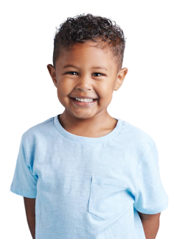
20 YEARS
IN VPK
Honoring
Early Childhood VPK Classroom Educators
Notes:
Today, we honor more than years of service as we recognize two decades of dedication, achievement, and the many ways you have positively impacted the lives of children and families in VPK. Your journey reflects a legacy of dedication, joy that brightens every classroom, and wisdom that continues to guide and inspire those around you.

Slide 2


TEACHERS & PARAPROFESSIONALS
Elba Abrahante
Shalon Anderson
Cristina Chica
Lilian Crousillat
Nicole Daryadel
Iliana Delgado
Gina Domond
Diana Faget
Roxana Flores
Lucy Franky
Debra Gamundi
Marlen Gomez
Claudia Gonzalez
Isabel Gonzalez
Joann Greene
Dara Gutierrez
Laura Hernandez
Zonia Illa
Edna James
Delia Katz
Dana Kramer
Miurka Lebron
Alina Leyva
Theresa McNamara
Jeanette Osuna
Zaida Perez
Ana Pinillos
Rosa Quintero
Cristina Ravelo
Erin Reusch
Tammy Riley
Lolliette Romero
Roxanne Rotger
Cristina Rubio
Lianna Saenz
Carla Schuab
Rosella Simoni
Karen Solis
Alicia Velazquez
Susana Villotta
Cynthia Warren

Slide 3
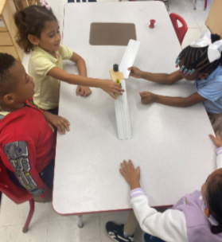
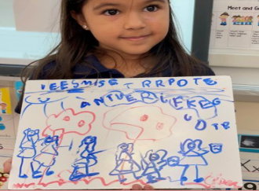

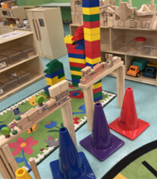
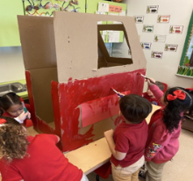
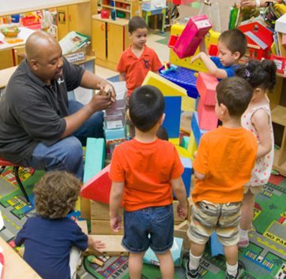
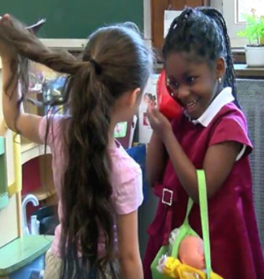
Years of VPK
165,058
Students Prepared
Families Engaged
Opportunities Created
2005 - 2025
Data Source: ARDA 2020-2025
Notes:
Thank you for your commitment, compassion, and creativity. You make a lasting impact in the lives of children.

