Slide 1

SCHOOL BOARD CONFERENCE SESSION
ATTENDANCE ZONE RECOMMENDATIONS
2026 - 2027
WEDNESDAY, APRIL 22, 2026

Slide 2

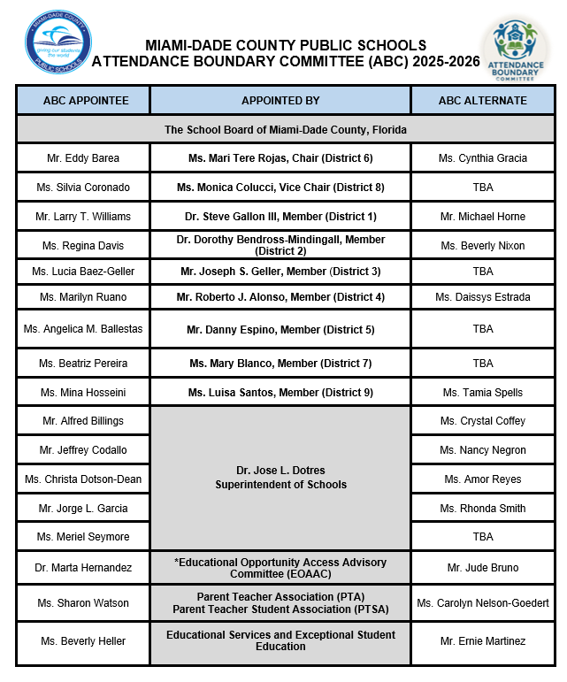

Slide 3
Attendance Boundary Committee (ABC) Timeline at a Glance
Thursday, October 23, 2025 | Orientation meeting for ABC members
Thursday, November 20, 2025 | Presentation of initially targeted/advised school recommendations to ABC
Friday, November 21, 2025 | Principals of initially targeted/advised schools were notified, and communications were sent to parents
Thursday, December 4, 2025 | ABC identified final targeted/advised schools
Friday, December 5, 2025 | Principals of final targeted/advised schools were notified
Wednesday, December 10, 2025 | Regions submit community meeting dates
January 5, 2026 – January 30, 2026 | Community Meetings were conducted for Targeted and Advised schools.
Thursday, February 19, 2026 | ABC reviewed recommendations submitted by community/Region Offices and approved the final targeted and advised schools
Thursday, March 12, 2026 | ABC boundary recommendations were presented at the Educational Opportunity Access Advisory Committee (EOAAC) meeting
Thursday, March 17, 2026 | Region Superintendents present recommendations approved by the ABC to Superintendent of Schools, School Board Attorney and appropriate staff.
Wednesday, April 22, 2026 | School Board Conference Session and Initial Reading for Attendance Zones 2026-2027
Wednesday, June 17, 2026 | School Board Meeting - Final Reading Attendance Zones for 2026-2027

Slide 4

Ability to conduct a viable educational due to declining enrollment
Compliance with Class Size Reduction Mandate
Impact on Exceptional Student Education programs
Use of available student stations within contiguous areas
Degree and extent of transportation
Programmatic impact due to lack of student housing
Reduction of the number of schools students must attend
Integrity of feeder systems
Impact of new residential developments
Attendance Boundary Committee (ABC)
Factors
Considered
Construction of new schools
Impact of changes to other school boundaries
5

Slide 5
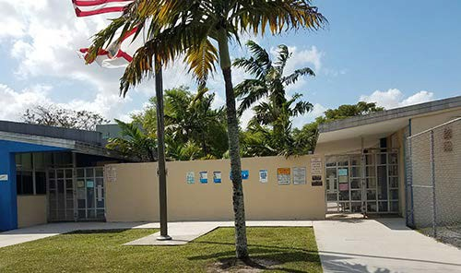
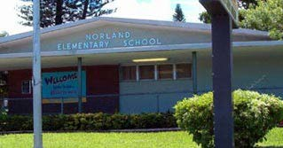

Proposed Attendance Boundary Recommendations
North Region Office
Parkway Elementary School Norland Elementary School
Dr. Yesenia M. Aponte
Region Superintendent
Mr. Leonard Torres
ABC Region Director

Slide 6
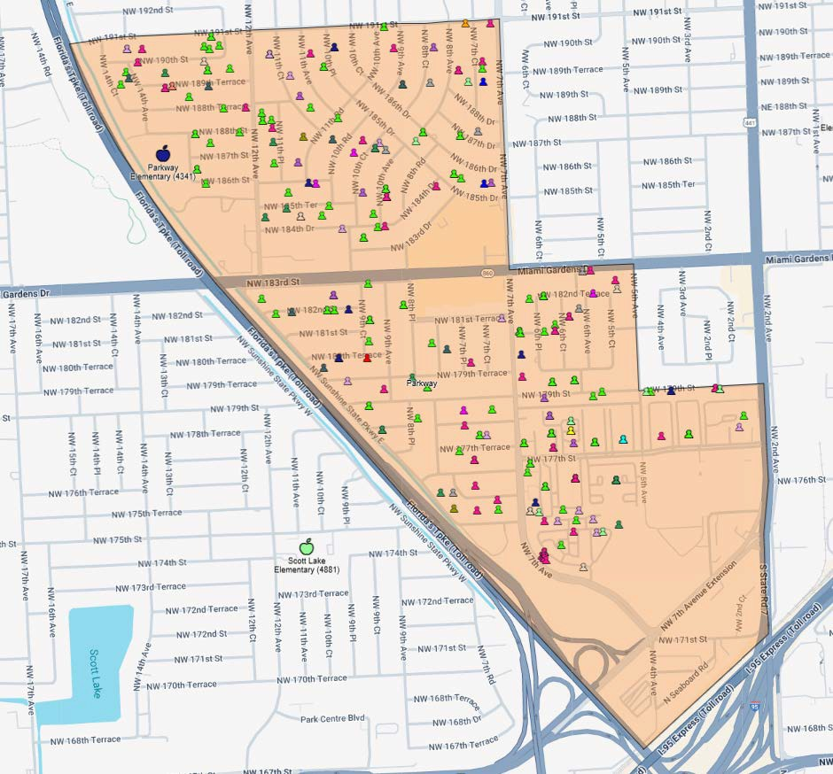
Parkway Elementary Boundary
321 elementary age students live inside the Parkway Elementary Attendance Boundary area
129 (40%) attend Parkway Elementary School
28 (9%) attend Norland Elementary School

Slide 7
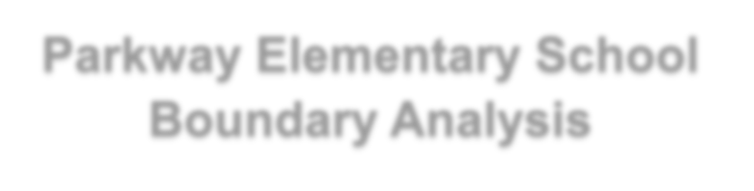





Parkway Elementary School Boundary Analysis
Grades K-5 Students Living within Boundary Residing: 321
School Name (Enrolled) | Count | %
Parkway Elementary (4341) | 129 | 40.19%
Norland Elementary (3701) | 29 | 9.03%
Norwood Elementary (4001) | 25 | 7.79%
Scott Lake Elementary (4881) | 21 | 6.54%
Excelsior Charter Academy (5032) | 17 | 5.3%
Crestview Elementary (1161) | 9 | 2.8%
N. Dade Ctr For Modern Lang (5131) | 8 | 2.49%
Joella C. Good Elementary (2181) | 6 | 1.87%
Kipp Miami - Liberty City (2332) | 6 | 1.87%
Bridgeprep Acad. Miami Gardens (0026) | 5 | 1.56%
Bunche Park Elementary (0641) | 5 | 1.56%
Hibiscus Elementary (2401) | 5 | 1.56%
Hive Preparatory School (1014) | 5 | 1.56%
Data source: Frontline/Location Analytics 12/12/25

Slide 8
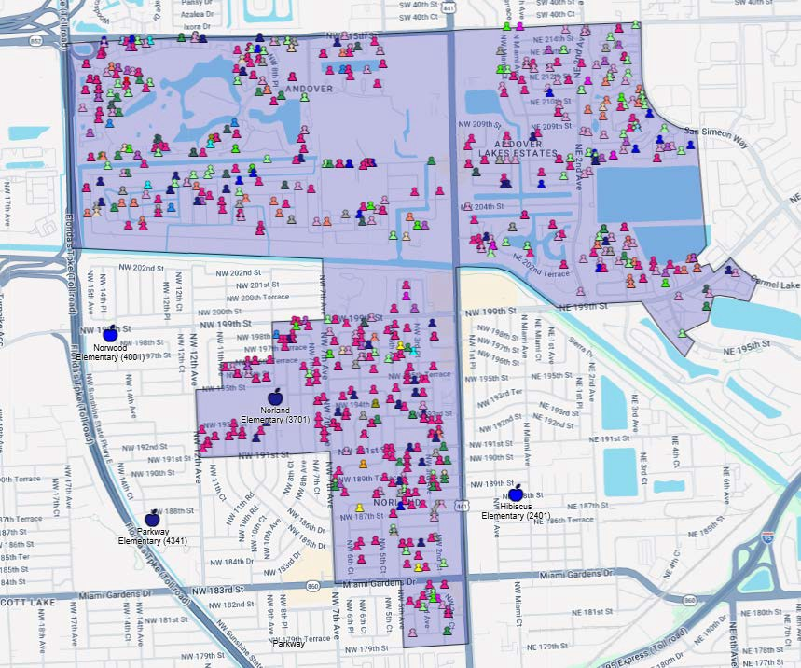
Norland Elementary Boundary
892 elementary age students live inside the Norland Elementary Attendance Boundary area
352 (39%) attend Norland Elementary School
5 (<1%) attend Parkway Elementary School

Slide 9
Enrollment
Parkway Elementary School
Enrollment Trend Analysis
GRADE LEVEL | 2024 - 2025 | 2025 - 2026
K | 22 | 12
1 | 28 | 24
2 | 20 | 23
3 | 37 | 26
4 | 28 | 28
5 | 26 | 29
TOTAL | 161 | 142
Exiting Cohort | 26 | -14
Incoming Cohort | 12
*Data pulled from February 2025 & February 2026 FTE Surveys
UTILIZATION & CAPACITY | ENROLLMENT | PERCENT UTILIZATION (CAPACITY: 478)
20-21 | 250 | 52.3%
21-22 | 230 | 48.1%
22-23 | 216 | 45.2%
23-24 | 216 | 45.2%
24-25 | 178 | 37.2%
25-26 | 138* | 28.9%*
Enrollment Data: ARDA, Capacity Data: FISH Reports * PARI 3/30/2026

Slide 10
Impact
Due to declining enrollment and the ability to conduct a viable educational program, the following recommendations are proposed
Dissolve the current boundary for Parkway Elementary School.
Combine the boundaries of Norland Elementary School and Parkway Elementary School.
Establish new boundaries for Norland Elementary School.
11
Notes:
Presenter
2026-03-16 12:32:27
--------------------------------------------
Debido a la disminución de la matrícula y la capacidad de llevar a cabo un programa educativo viable, se proponen las siguientes recomendaciones:

Slide 11
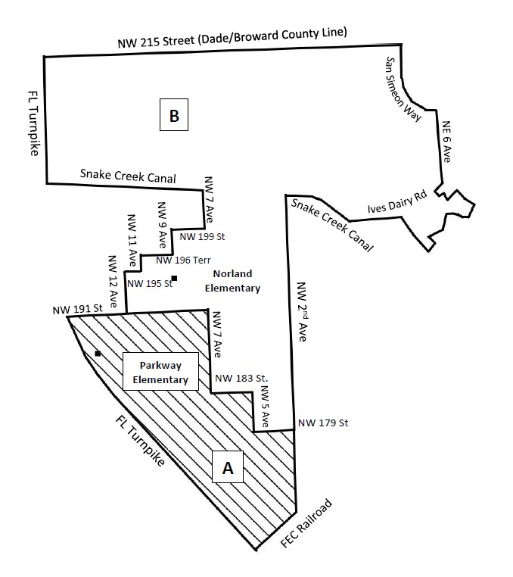
Impact
A
Area A represents the current boundary for Parkway Elementary.
B
Area B represents the current boundary for Norland Elementary.
A B
Areas A and B represent the proposed new boundary for Norland Elementary.
12

Slide 12
Current Boundaries
Assigned current boundary for Parkway Elementary School
Begin at Florida Turnpike and NW 191 Street
East to NW 7 Avenue
South to NW 183 Street
East to NW 5 Avenue
South to NW 179 Street
East to NW 2 Avenue
South to FEC Railroad
Southwest to Florida Turnpike
Northwest to NW 191 Street,
point of beginning.

Slide 13
Current Boundaries
Assigned current boundary for Norland Elementary School
Begin at Sunshine State Parkway and NW 215 Street (Dade/Broward County Line)
East to San Simeon Way
Southeast to NE 6 Avenue extended
South to Snake Creek Canal
Northwest along canal to NW 2 Avenue
South to NW 179 Street
West to NW 5 Avenue
North to NW 183 Street
West to NW 7 Avenue
North to NW 191 Street
West to NW 12 Avenue
North to NW 195 Street
East to NW 11 Avenue
North to NW 196 Terrace
East to NW 9 Avenue
North to NW 199 Street
East to NW 7 Avenue
North to Snake Creek Canal
West to Florida Turnpike
North to NW 215 Street (Dade/Broward County Line),
point of beginning.

Slide 14
Recommended Boundaries
Proposed boundary for Norland Elementary School
Begin at Florida Turnpike and NW 215 Street (Dade/Broward County Line)
East to San Simeon Way
Southeast to NE 6 Avenue extended
South to Ives Dairy Road
East to Carmel Lake Road
Along Carmel Lake Rd to NE 6 Court
Southwest to NE 195 Street (lake)
North to Ives Dairy Road
West to Snake Creek Canal
Northwest along canal to NW 2 Avenue
South to FEC Railroad
Southwest to Florida Turnpike
Northwest to NW 191 Street,
East to NW 12 Avenue
North to NW 195 Street
East to NW 11 Avenue
North to NW 196 Terrace
East to NW 9 Avenue
North to NW 199 Street
East to NW 7 Avenue
North to Snake Creek Canal
West to Florida Turnpike
North to NW 215 Street (Dade/Broward County Line),
point of beginning.

Slide 15
Effects
Beginning with the 2026-2027 School Year:
New boundaries will be established for Norland Elementary School to include the Parkway Elementary School boundary (Area A).
Norland Elementary will be the new boundary elementary school for students in K-5 residing in area A.
Approximately 106 rising 1st through 5th grade students, currently attending Parkway Elementary and residing in Area A, may attend Norland Elementary School.
Nine rising 1st through 5th grade students attending Parkway Elementary residing outside of the school boundary will have the option to attend Norland Elementary School.
Norland Elementary will have new boundaries.
Middle School boundaries will remain the same.
High School boundaries will remain the same.
16

Slide 16
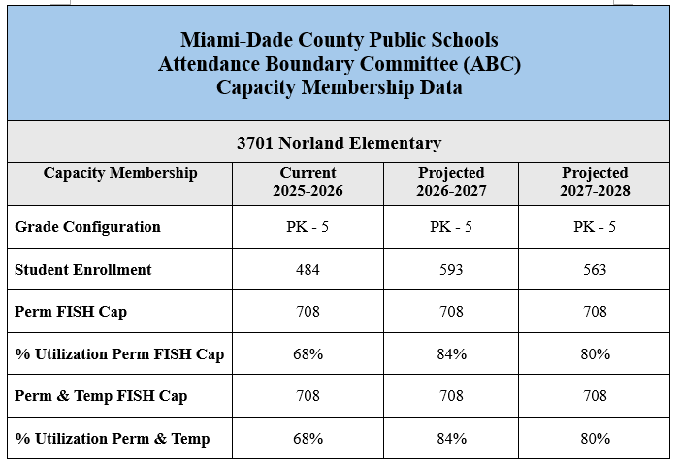
Effects

Slide 17
Effects
Norland Elementary’s building student capacity is larger than Parkway Elementary. It can accommodate 708 students.
Norland Elementary is a B rated school offering a full-time gifted program.
Norland Elementary offers a variety of extracurricular clubs such as:
STEAM
Robotics Club
Norland Elementary offers a multitude of Leadership and Character Programs such as:
5000 Role Models of Excellence
ButterF.L.Y. Girls Self-Esteem Program
Florida Educators of America - F.E.A.
Care Bear Wellness Champions (Social Emotional Wellness Club)
Norland Bears Headline News Broadcasting/Anchor Team
Positive Behavior Support
Do the Right Thing Acknowledgement Program
Norland Elementary offers free After-care for the first 90 students to register

Slide 18
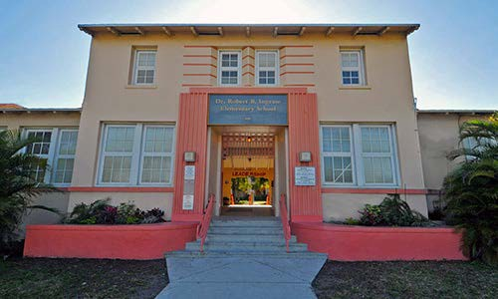
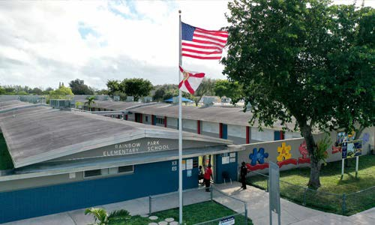
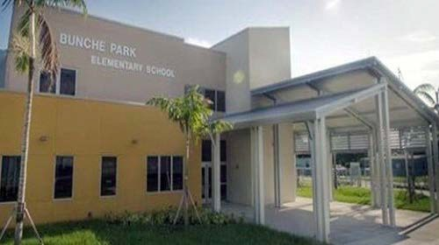

Proposed Attendance Boundary Recommendations
North Region Office
Rainbow Park Elementary School Bunche Park Elementary School
Dr. Robert B. Ingram Elementary School
Dr. Yesenia M. Aponte
Region Superintendent
Mr. Leonard Torres
ABC Region Director

Slide 19
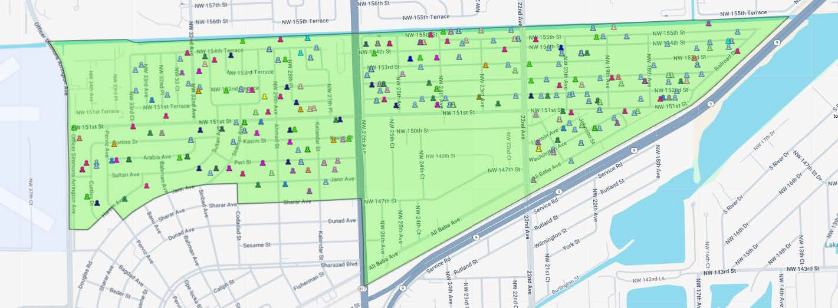
Rainbow Park Elementary Boundary
298 elementary age students live inside the Rainbow Park Elementary Attendance Boundary area
105 attend Rainbow Park Elementary
35% of area students

Slide 20





Rainbow Park School Boundary Analysis
Grades K-5 Students Living within Boundary Residing: 298
School Name (Enrolled) | Count | %
Rainbow Park Elementary (4541) | 105 | 35.23%
Dr. Robert B. Ingram El (4121) | 19 | 6.38%
Bunche Park Elementary (0641) | 14 | 4.7%
Amelia Earhart Elementary (1521) | 12 | 4.03%
Mater Academy (0100) | 10 | 3.36%
Palm Springs Elementary (4261) | 9 | 3.02%
Excelsior Charter Academy (5032) | 8 | 2.68%
Kipp Miami - Liberty City (2332) | 8 | 2.68%
Nathan Young Elementary (5971) | 8 | 2.68%
Scott Lake Elementary (4881) | 8 | 2.68%
Data source: Frontline/Location Analytics 12/12/25

Slide 21
Enrollment
Rainbow Elementary School
Enrollment Trend Analysis
GRADE LEVEL | 2024 - 2025 | 2025 - 2026
K | 25 | 19
1 | 21 | 26
2 | 38 | 17
3 | 26 | 33
4 | 23 | 24
5 | 26 | 19
TOTAL | 159 | 138
Exiting Cohort | 26 | -7
Incoming Cohort | 19
*Data pulled from February 2025 & February 2026 FTE Surveys
UTILIZATION & CAPACITY | ENROLLMENT | PERCENT UTILIZATION (CAPACITY:542)
20-21 | 217 | 40.0%
21-22 | 215 | 39.7%
22-23 | 224 | 41.3%
23-24 | 196 | 36.2%
24-25 | 172 | 31.7%
25-26 | 128* | 23.6%*
Enrollment Data: ARDA, Capacity Data: FISH Reports * PARI 3/30/2026

Slide 22
Impact
Due to declining enrollment and the ability to conduct a viable educational program the following recommendations are proposed.
Dissolve the current boundary for Rainbow Park Elementary School.
Divide the Rainbow Park Elementary School boundary between Bunche Park Elementary and Dr. Robert B. Ingram Elementary using NW 27 Avenue as the dividing line.
Establish new boundaries for Bunche Park and Dr. Robert B. Ingram Elementary Schools.
21
Notes:
Presenter
2026-03-16 12:32:30
--------------------------------------------
Debido a la disminución de la matrícula y la capacidad de llevar a cabo un programa educativo viable, se proponen las siguientes recomendaciones:

Slide 23
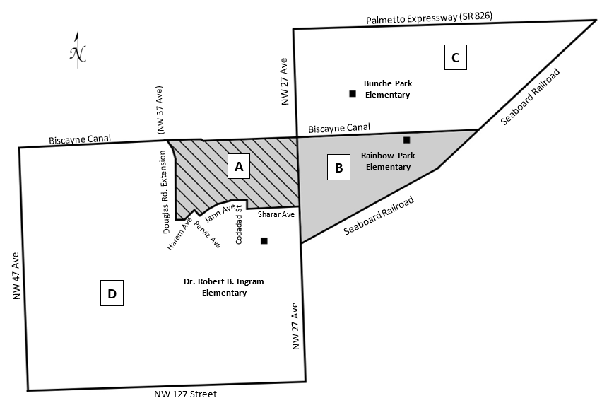
Recommendations
A B
Areas A and B represent the current boundary for Rainbow Park Elementary.
C
Area C represents the current boundary for Bunche Park Elementary.
Area D represents the current boundary for Dr. Robert B. Ingram Elementary.
D
A D
Areas A and D represent the proposed new boundary for Dr. Robert B. Ingram Elementary.
22
B C
Areas B and C represent the proposed new boundary for Bunche Park Elementary.

Slide 24
Current Boundaries
Assigned current boundary for Rainbow Park Elementary School
Begin at the Biscayne Canal and the Seaboard Railroad
West on the Biscayne Canal to Douglas Road extended
South to Harem Avenue
East to Pervis
South to Jann Avenue
East to Codadad Street
South to Sharar Avenue
East to NW 27 Avenue
South to Seaboard Railroad
Northeast to Biscayne Canal,
point of beginning.

Slide 25
Current Boundaries
Assigned current boundary for Bunche Park Elementary School
Begin at Begin at Palmetto Expressway (SR 826) at NW 27 Avenue
South on NW 27 Avenue to Biscayne Canal
East to Seaboard Railroad
Northeast to Palmetto Expressway Interchange (SR 826)
West on Palmetto Expressway (SR 826) to NW 27 Avenue,
point of beginning.

Slide 26
Current Boundaries
Assigned current boundary for Dr. Robert B. Ingram Elementary School
Begin at Begin at NW 27 Avenue and Sharar Avenue
West to Codadad Street
North to Jann Avenue
Southwest to Perviz
North to Harem Avenue
Southwest to Douglas Road Extension (approximately NW 37 Avenue)
North to Biscayne Canal
West to NW 47 Avenue
South to NW 127 Street
East to NW 27 Avenue
North to Sharar Avenue,
point of beginning.

Slide 27
Recommended Boundaries
Proposed boundary for Bunche Park Elementary School
Begin at Palmetto Expressway (SR 826) at NW 27 Avenue
South to Seaboard Railroad
Northeast to Palmetto Expressway (SR 826) Interchange
West on Palmetto Expressway (SR 826) to NW 27 Avenue,
point of beginning.

Slide 28
Recommended Boundaries
Proposed boundary for Dr. Robert B. Ingram Elementary School
Begin at Begin at NW 27 Avenue and Biscayne Canal
West to NW 47 Avenue
South to NW 127 Street
East to NW 27 Avenue
North to Biscayne Canal,
point of beginning.

Slide 29
Effects
Beginning with the 2026-2027 School Year:
New boundaries will be established for Dr. Robert B. Ingram Elementary School to include the West portion of Rainbow Park Elementary School boundary (Area A).
Dr. Robert B. Ingram Elementary School will be the new boundary elementary school for students in K – 5 residing in Area A.
Approximately 28 rising 1st through 5th grade students, currently attending Rainbow Park Elementary and residing in Area A, may attend Dr. Robert B. Ingram Elementary School.
The Dance Magnet program will move to Dr. Robert B. Ingram Elementary School – Approximately 18 rising 1st through 5th grade students participating in the Dance Magnet, (11 from inside the Rainbow Park Boundary and 7 from outside the boundary), will continue in the program. Dr. Robert B. Ingram Elementary has a larger capacity, providing an opportunity for the Dance Magnet program to grow.
28

Slide 30
Effects
Beginning with the 2026-2027 School Year:
New boundaries will be established for Bunche Park Elementary School to include the East portion of Rainbow Park Elementary School boundary (Area B).
Bunche Park Elementary School will be the new boundary elementary school for students in K – 5 residing in Area B.
Approximately 63 rising 1st through 5th grade students, currently attending Rainbow Park Elementary and residing in Area B, may attend Bunche Park Elementary School.
Sixteen rising 1st through 5th grade students attending Rainbow Park Elementary but residing outside of the school boundary will have the choice option to attend Bunche Park Elementary, Dr. Robert B. Ingram Elementary.
Middle School and High School boundaries will remain the same.
29

Slide 31
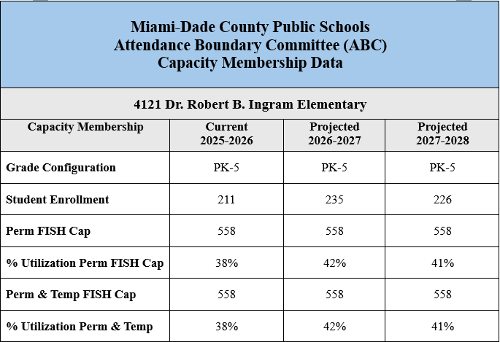
Effects
29

Slide 32
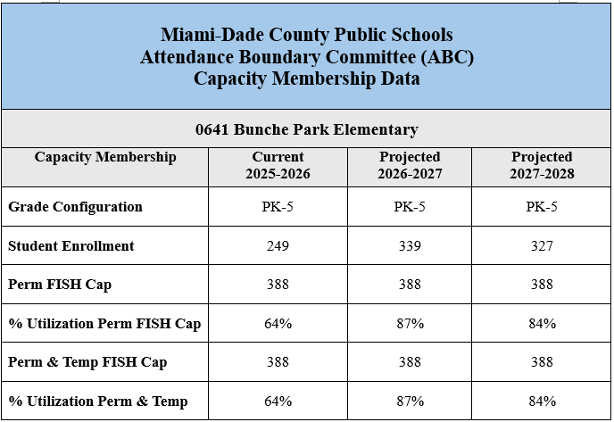
Effects
29

Slide 33
Effects
Dr. Robert B. Ingram Elementary is a B rated school offering a gifted program.
Dr. Robert B. Ingram Elementary offers two after school programs and extended learning opportunities.
Dr. Robert B. Ingram Elementary offers a variety of extracurricular clubs such as:
5000 Role Models ​
Young Ladies of Royalty​
Chess​
Dance​
Legos​
29

Slide 34
Effects
Bunche Park Elementary offers an ASD Program K-5.
Bunche Park Elementary offers after school care and extended learning opportunities.
Bunche Park Elementary offers a variety of extracurricular clubs such as:
STEM​
Mentorship & Tutoring​
Drama & Dance Club​
29

Slide 35


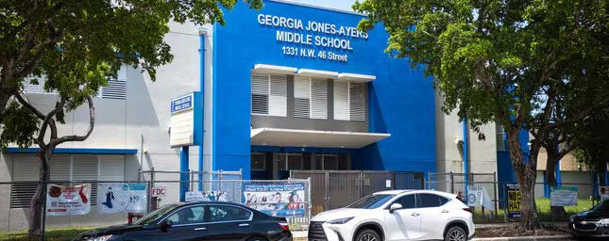
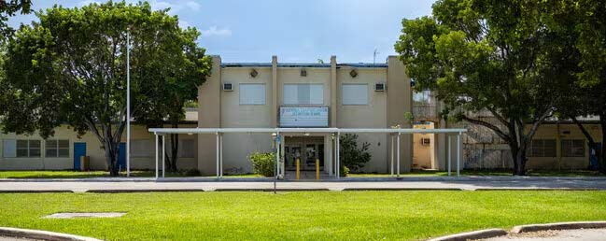





Proposed Attendance Boundary Recommendations
Central Region Office
Georgia Jones-Ayers Middle School
Lenora B. Smith Elementary School
Georgia Jones-Ayers Middle School Lenora B. Smith Elementary School
Ms. Brenda Swain
Region Superintendent
Mr. Manuel S. Garcia
ABC Region Director

Slide 36
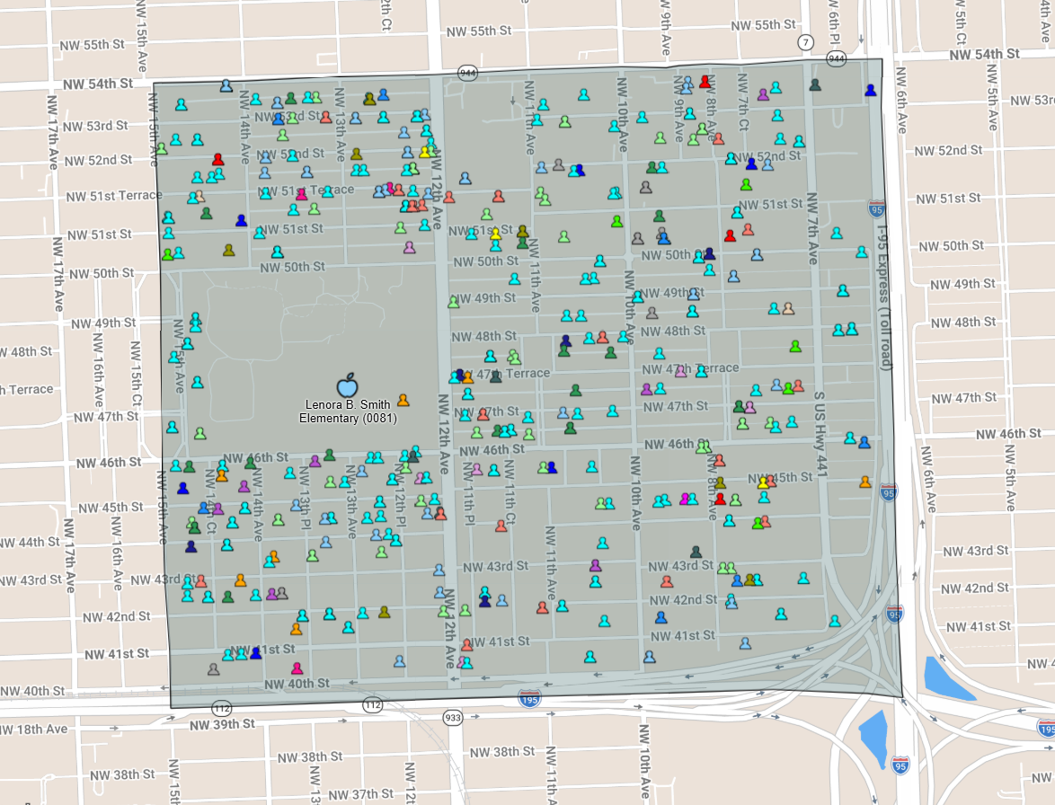
Boundary Analysis
Lenora B. Smith Elementary School
474 elementary age students live inside the Attendance Boundary
210 attend Lenora B. Smith Elementary School
44.3% of area students

Slide 37
Boundary Analysis
Lenora B. Smith Elementary School
474 PreK – 5th Grade Students in Boundary
School Name (Enrolled in Boundary) | Count | %
Lenora B. Smith Elementary (0081) | 210 | 44.30%
Mater Academy Of Intl Studies (1017) | 33 | 6.96%
Agenoria S. Paschal/Olinda El (4071) | 18 | 3.80%
Orchard Villa Elementary (4171) | 15 | 3.16%
Dr. Charles R. Drew K-8 Center (1401) | 14 | 2.95%
Kipp Miami - Liberty City (2332) | 11 | 2.32%
Comstock Elementary (0881) | 10 | 2.11%
Kelsey L. Pharr Elementary (4401) | 10 | 2.11%
Santa Clara Elementary (4841) | 10 | 2.11%
Downtown Miami Charter School (3600) | 7 | 1.48%
Ipreparatory Academy (7581) | 7 | 1.48%
Mater Preparatory Academy (3003) | 7 | 1.48%
Melrose Elementary (3181) | 7 | 1.48%
Arcola Lake Elementary (0101) | 6 | 1.27%
Bridgeprep. Acad. Greater Miami (2013) | 6 | 1.27%
Lincoln-Marti Cs Little Havana (5025) | 6 | 1.27%
Snapshot of highest enrolling schools.
Source: Frontline/Location Analytics, 03/13/26

Slide 38
Enrollment
Lenora B. Smith Elementary School
Enrollment Trend Analysis
GRADE LEVEL | 2024 - 2025 | 2025 – 2026
K | 42 | 30
1 | 38 | 40
2 | 48 | 32
3 | 71 | 52
4 | 56 | 56
5 | 66 | 46
TOTAL | 321 | 256
Exiting Cohort | 65 | -46
Incoming Cohort | 19
*Data pulled from February 2025 & February 2026 FTE Surveys
UTILIZATION & CAPACITY | ENROLLMENT | PERCENT UTILIZATION (CAPACITY: 754)
20-21 | 404 | 53.6%
21-22 | 358 | 47.5%
22-23 | 367 | 48.7%
23-24 | 341 | 45.2%
24-25 | 353 | 46.8%
25-26 | 256 | 36.5%
Enrollment Data: ARDA, Capacity Data: FISH Reports

Slide 39
Impact
Due to the declining enrollment over the past five years and the underutilization of both Georgia Jones-Ayers Middle School and Lenora
B. Smith Elementary School, the following recommendation is proposed:
Dissolve the current Georgia Jones-Ayers Middle School boundary.
Combine Georgia Jones-Ayers Middle School and Lenora B. Smith Elementary School as a K-8 Center.
31

Slide 40

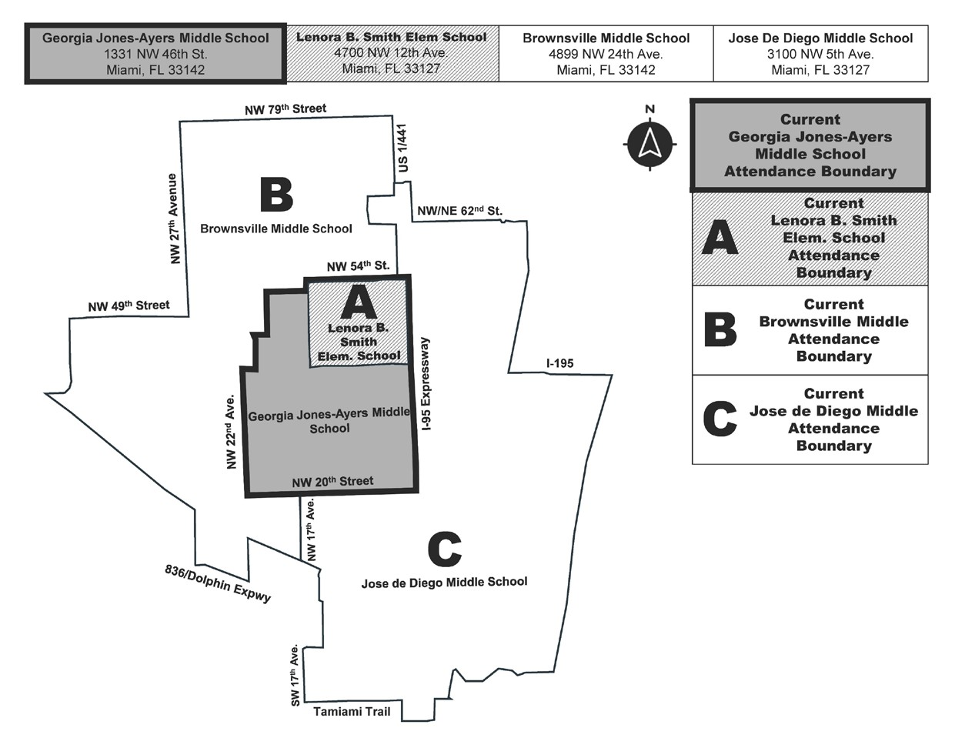
Recommended Boundaries

Slide 41
Current Boundary
Lenora B. Smith Elementary School
Begin at NW 15 Avenue and NW 54 Street
East on NW 54 Street to I-95
South on I-95 to State Road 112
West on State Road 112 to NW 15 Avenue
North on NW 15 Avenue to NW 54 Street,
point of beginning.
32

Slide 42
Current Boundary
Georgia Jones-Ayers Middle School
Begin at North-South Expressway (I-95) and NW 54 Street
South to NW 20 Street
West to NW 22 Avenue
North to Airport Expressway (112)
East to NW 21 Avenue
North to NW 46 Street
East to NW 19 Avenue
North to NW 52 Street
East to NW 15 Avenue
North to NW 54 Street
East to North-South Expressway (I-95), point of beginning.
33

Slide 43
Effects
Beginning with the 2026-2027 School Year:
Combine Georgia Jones-Ayers Middle School and Lenora B. Smith Elementary School as a K-8 Center.
All current elementary students in the Georgia Jones-Ayers boundary may attend Georgia Jones-Ayers/Lenora B. Smith K-8 Center.
All current 6th and 7th grade students attending Georgia Jones-Ayers Middle School may attend Georgia Jones-Ayers/Lenora B. Smith K-8 Center.
All middle grade students (6th – 8th) residing in the George Jones-Ayers/Lenora B. Smith K-8 boundary will have the option to attend George Jones-Ayers/Lenora B. Smith K-8 for grades 6th – 8th or may attend the boundary residence middle school.
Preserve both names, Georgia Jones-Ayers & Lenora B. Smith, as a combined name, Georgia Jones-Ayers/Lenora B. Smith K-8 Center, as recommended from community feedback.
36

Slide 44
Effects
Beginning with the 2026-2027 School Year:
Miami-Dade County Public Schools Attendance Boundary Committee (ABC) Capacity Membership Data
Georgia Jones-Ayers/Lenora B. Smith K8 Center
Capacity Membership | Current 2025-2026 | Projected 2026-2027 | Projected 2027-2028
Grade Configuration | Middle School (6-8) | K8 Center (PK-8) | K8 Center (PK-8)
Student Enrollment | 448 | 701 | 680
Perm FISH Cap | 1154 | 1154 | 1154
% Utilization Perm FISH Cap | 38.82 | 60.74% | 58.92%
Perm & Temp FISH Cap | 1154 | 1154 | 1154
% Utilization Perm & Temp | 38.82 | 60.74% | 58.92%
36

Slide 45

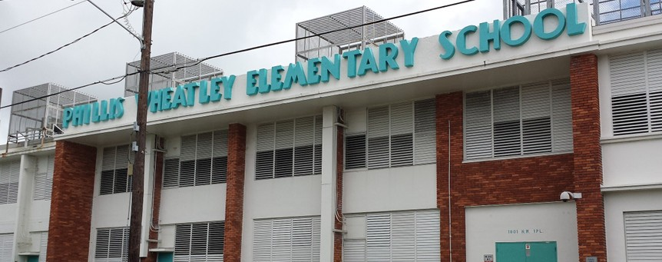



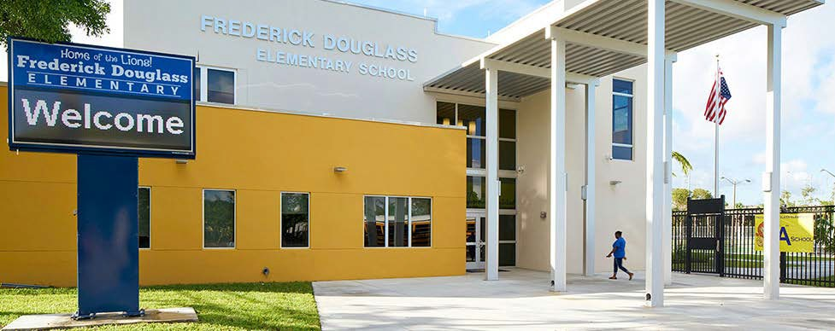

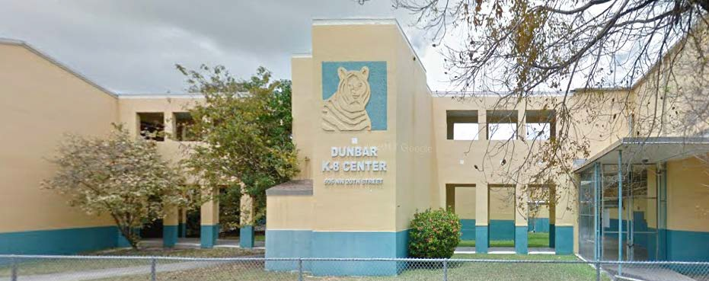

Proposed Attendance Boundary Recommendations
Central Region Office
Phillis Wheatley Elementary School
Frederick Douglass Elementary School
Paul L. Dunbar K-8 Center
Phillis Wheatley Elementary School
Frederick Douglass Elementary School
Paul L. Dunbar K-8 Center
Ms. Brenda Swain
Region Superintendent
Mr. Manuel S. Garcia
ABC Region Director

Slide 46
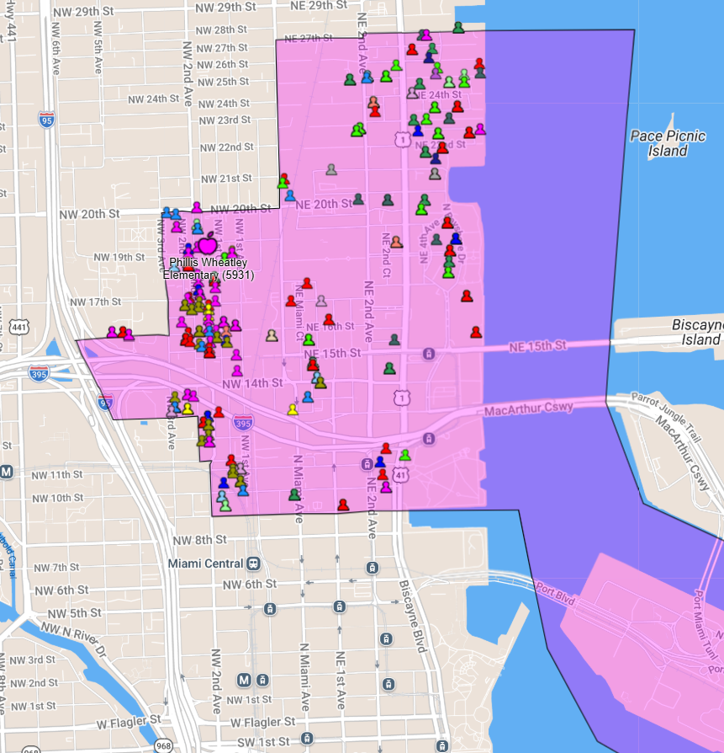
Boundary Analysis
Phillis Wheatley Elementary School
837 elementary age students live inside the Attendance Boundary
132 attend Phillis Wheatley Elementary School
15.77% of area students

Slide 47
Boundary Analysis
Phillis Wheatley Elementary School
837 PreK – 5th Grade Students in Boundary
School Name (Enrolled in Boundary) | Count | %
Phillis Wheatley Elementary (5931) | 132 | 15.77%
Bridgeprep Acad Greater Miami (2013) | 106 | 12.66%
Miami Children’s Museum (4000) | 94 | 11.23%
Ipreparatory Academy (7581) | 69 | 8.24%
Frederick Douglass Elementary (1361) | 59 | 7.05%
Gibson Charter School (2060) | 53 | 6.33%
Downtown Miami Charter School (3600) | 39 | 4.66%
Southside Preparatory Academy (5321) | 29 | 3.46%
Ada Merritt K-8 Center (3191) | 28 | 3.35%
Paul Laurence Dunbar K-8 Ctr (1441) | 14 | 1.67%
Citrus Grove K-8 Center (0801) | 12 | 1.43%
Mater Academy East Charter (3100) | 12 | 1.43%
Chapman Partnership Ecc North (0331) | 9 | 1.08%
Mater Academy Of Intl Studies (1017) | 9 | 1.08%
Mater Grove Academy (5045) | 9 | 1.08%
Snapshot of highest enrolling schools.
Source: Frontline/Location Analytics, 03/13/26

Slide 48
Enrollment
Phillis Wheatley Elementary School
Enrollment Trend Analysis
GRADE LEVEL | 2024 - 2025 | 2025 – 2026
K | 26 | 17
1 | 19 | 23
2 | 28 | 19
3 | 33 | 29
4 | 14 | 27
5 | 19 | 18
TOTAL | 147 | 139
Exiting Cohort | 19 | -13
Incoming Cohort | 6
*Data pulled from February 2025 & February 2026 FTE Surveys
UTILIZATION & CAPACITY | ENROLLMENT | PERCENT UTILIZATION (CAPACITY: 620)
20-21 | 194 | 31.3%
21-22 | 190 | 30.6%
22-23 | 179 | 28.9%
23-24 | 157 | 25.3%
24-25 | 147 | 23.7%
25-26 | 139 | 22.4%
Enrollment Data: ARDA, Capacity Data: FISH Reports

Slide 49
Impact
Due to declining enrollment and the ability to conduct a viable educational program, the following recommendations are proposed:
Dissolve the current boundary for Phillis Wheatley Elementary School.
Divide the Phillis Wheatley Elementary School boundary between Frederick Douglass Elementary (Area D) and Paul L. Dunbar K-8 Center (Areas B).
Establish new boundaries for Frederick Douglass Elementary School (Areas C & D) and Paul L. Dunbar K-8 Center (Areas A & B).
38

Slide 50

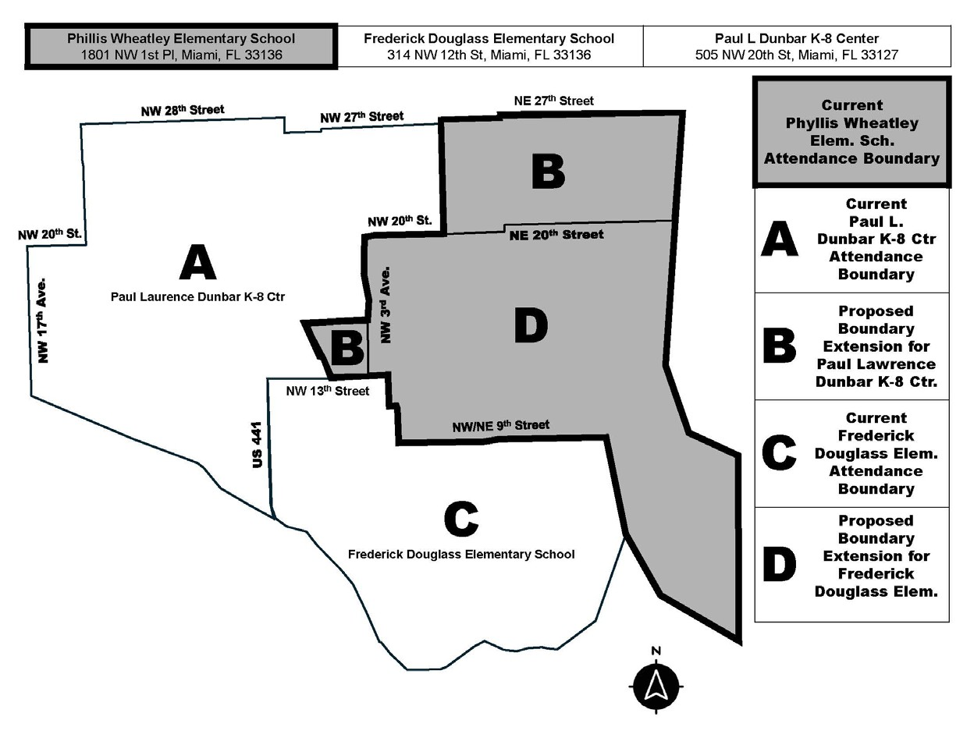
Recommended Boundaries

Slide 51
Current Boundary
Phillis Wheatley Elementary School
Begin at North-South Expressway (I-95) and NW 16 Street
East to NW 3 Avenue North to NW 20 Street
East to Miami Avenue North to NW 27 Street
East to Biscayne Bay
South to Government Cut and Dodge Island, encompassing all of Dodge Island
Northwest to NE 9 Street
West to NW 2 Avenue
North to NW 13 Street
West to North-South Expressway (I-95)
North to NW 16 Street,
point of beginning.

Slide 52
Current Boundary
Frederick Douglass Elementary School
Begin at Biscayne Bay and NE 9 Street
West on NE 9 Street to NW 2 Avenue
North to NW 13 Street
West to NW 7 Avenue
South to the Miami River
Southeast to North-South Expressway (I-95)
Southeast to Biscayne Bay
Northeast to NE 9 Street,
point of beginning.

Slide 53
Current Boundary
Paul Laurence Dunbar K-8 Center
Begin at NW 14 Avenue and NW 28 Street
East on NW 28 Street to North- South Expressway (I-95)
South to NW 27 Street
East to Miami Avenue
South to NW 20 Street
West to NW 3 Avenue
South to NW 16 Street
West to North-South Expressway (I-95)
South to NW 13 Street
West to NW 7 Avenue
South to the Miami River
Northwest to NW 17 Avenue
North to NW 20 Street
East to NW 14 Avenue
North to NW 28 Street,
point of beginning.

Slide 54
Recommended Boundary
Proposed Boundary for Frederick Douglass Elementary School
Begin at North Miami Avenue and NE 20 Street
East to Biscayne Bay NW 2 Avenue and NW 9 Street
East to Biscayne Bay
South through MacArthur Causeway
East along MacArthur Causeway to the Eastern Most tip of Dodge
Island
West to the Miami River
Miami River Northwest to NW 7 Avenue
North to NW 13 Street
East to NW 3 Avenue
North to NW 20 Street
East to North Miami Avenue,
point of beginning.
44

Slide 55
Recommended Boundary
Proposed Boundary for Paul Laurence Dunbar K-8 Center
Begin at NW 17 Avenue and the Miami River
North to NW 20 Street
East to NW 14 Avenue
North to NW 28 Street
East to I-95
South to NW 27 Street
East to Biscayne Bay
South to NE 20 Street
West to NW 3 Avenue
South to NW 13 Street
West to 441/7 Avenue
South to The Miami River
Miami River to NW 17 Avenue
point of beginning.
45

Slide 56
Effects
Beginning with the 2026 - 2027 School Year:
New boundaries will be established for Frederick Douglass Elementary School and Paul L. Dunbar K-8 Center.
In Area B, approximately eleven (11) current kindergarten through fourth grade students in the boundary of Phillis Wheatley Elementary may attend Paul L. Dunbar K-8 Center.
In Area (D), approximately one hundred two (102) current kindergarten through fourth grade students in the boundary of Phillis Wheatley Elementary may attend Frederick Douglass Elementary.
All students residing in the combined boundaries of Phillis Wheatley Elementary, Frederick Douglass Elementary and Paul L. Dunbar K-8 Center may attend Jose de Diego Middle School as their middle school option.
46

Slide 57
Effects
Beginning with the 2026-2027 School Year:
Miami-Dade County Public Schools Attendance Boundary Committee (ABC) Capacity Membership Data
Frederick Douglass Elementary School
Capacity Membership | Current 2025-2026 | Projected 2026-2027 | Projected 2027-2028
Grade Configuration | Elementary (PK – 5) | Elementary (PK – 5) | Elementary (PK – 5)
Student Enrollment | 181 | 277 | 271
Perm FISH Cap | 275 | 275 | 275
% Utilization Perm FISH Cap | 65.81 | 100.7% | 98.54%
Perm & Temp FISH Cap | 275 | 275 | 275
% Utilization Perm & Temp | 65.81 | 100.7% | 98.54%
46

Slide 58
Effects
Beginning with the 2026-2027 School Year:
Miami-Dade County Public Schools Attendance Boundary Committee (ABC) Capacity Membership Data
Paul L. Dunbar K-8 Center
Capacity Membership | Current 2025-2026 | Projected 2026-2027 | Projected 2027-2028
Grade Configuration | K-8 Center (K-8) | K-8 Center (K-8) | K-8 Center (K-8)
Student Enrollment | 301 | 310 | 309
Perm FISH Cap | 788 | 788 | 788
% Utilization Perm FISH Cap | 38.19% | 39.34% | 39.21%
Perm & Temp FISH Cap | 788 | 788 | 788
% Utilization Perm & Temp | 38.19% | 39.34% | 39.21%
46

Slide 59


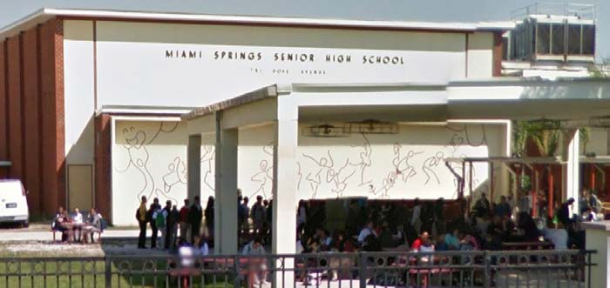
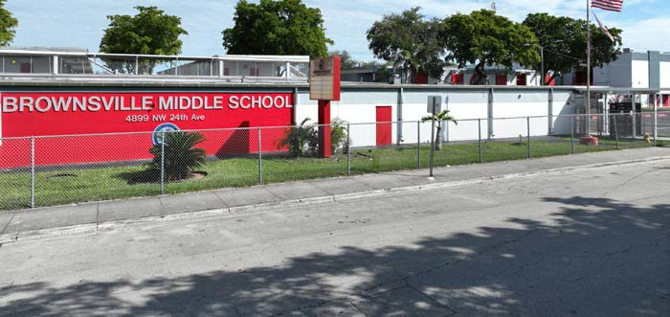


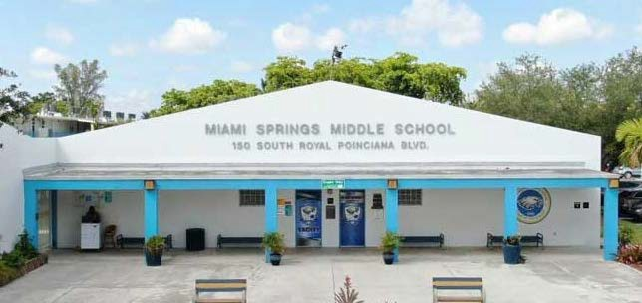





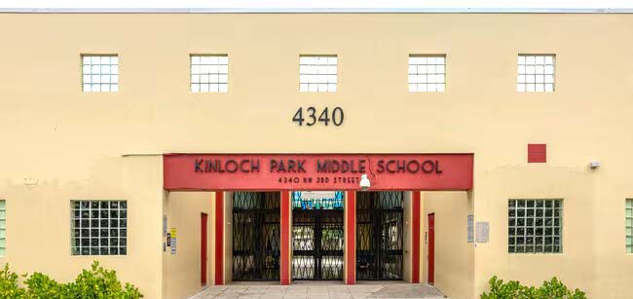
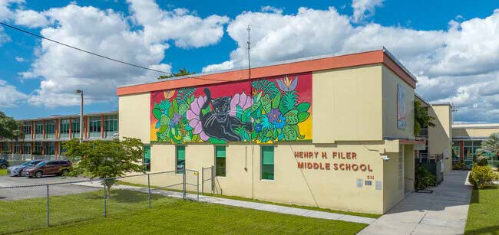


Proposed Attendance Boundary Recommendations
Central Region Office
Miami Springs Middle School
Miami Springs Senior High School
Brownsville Middle School
Kinloch Park Middle School
Henry H. Filer Middle School
Miami Springs Senior High School Brownsville Middle School
Ms. Brenda Swain
Region Superintendent
Miami Springs Middle School
Kinloch Park Middle School Henry H. Filer Middle School
Mr. Manuel S. Garcia
ABC Region Director

Slide 60
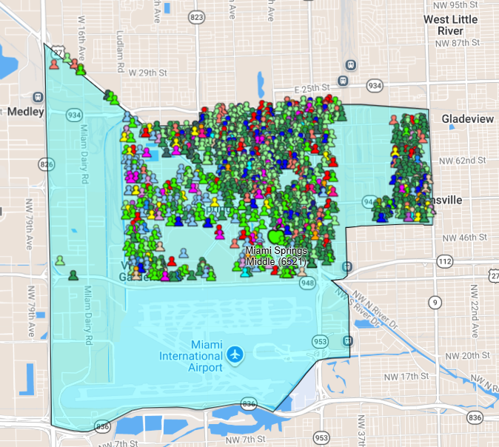
Boundary Analysis
Miami Springs Middle School
1627 elementary age students live inside the Attendance Boundary
441 attend Miami Springs Middle School
27.11% of area students

Slide 61
Boundary Analysis
Miami Springs Middle School
1,627 6th – 8th Grade Students n Boundary
School Name (Enrolled in Boundary) | Count | %
Miami Springs Middle (6521) | 441 | 27.11%
Imater Academy Middle School (6014) | 359 | 22.07%
Academy For Innovative Educ (6093) | 219 | 13.46%
Excelsior Prep Charter School (5029) | 83 | 5.10%
Doral Academy Charter Middle (6030) | 82 | 5.04%
Mater Academy Charter Middle (6012) | 67 | 4.12%
Hialeah Middle (6231) | 47 | 2.89%
Jose Marti Mast 6-12 Academy (7291) | 41 | 2.52%
Palm Springs Middle (6681) | 23 | 1.41%
Henry H. Filer Middle (6171) | 20 | 1.23%
Hialeah Gardens Middle School (6751) | 20 | 1.23%
Doral Academy Of Technology (3029) | 15 | 0.92%
Kipp Miami - Liberty City (2332) | 12 | 0.74%
City Of Hialeah Education Acad (7262) | 11 | 0.68%
Renaissance Charter School (6028) | 11 | 0.68%
Somerset Academy Middle-South (6013) | 11 | 0.68%
Snapshot of highest enrolling schools.
Source: Frontline/Location Analytics, 03/13/26

Slide 62
Enrollment
Miami Springs Middle School
Enrollment Trend Analysis
GRADE LEVEL | 2024 - 2025 | 2025 – 2026
6 | 199 | 183
7 | 240 | 179
8 | 221 | 208
TOTAL | 660 | 570
Exiting Cohort | 221 | -38
Incoming Cohort | 183
**Data pulled from February 2025 & February 2026 FTE Surveys
UTILIZATION & CAPACITY | ENROLLMENT | PERCENT UTILIZATION (CAPACITY: 1307)
20-21 | 702 | 53.7%
21-22 | 640 | 49%
22-23 | 710 | 54.3%
23-24 | 693 | 53%
24-25 | 660 | 50.5%
25-26 | 570 | 43.6%
Enrollment Data: ARDA, Capacity Data: FISH reports

Slide 63
Impact
Due to declining student enrolment at Miami Springs Middle School and Miami Springs Senior over the past five years, both schools have a building utilization under 55%. Thus, the following recommendation is proposed:
Dissolve the current boundary for Miami Springs Middle School.
Divide the Miami Springs Middle School boundary between Brownsville Middle (Area B), Kinloch Park Middle (Area D), and Henry H. Filer Middle (Areas F).
Establish Miami Springs Middle School and Miami Springs Senior High School as MSSH Preparatory Academy, a 6-12 configuration.
Efficient use of existing physical infrastructure at Miami Springs Senior High School.
48

Slide 64

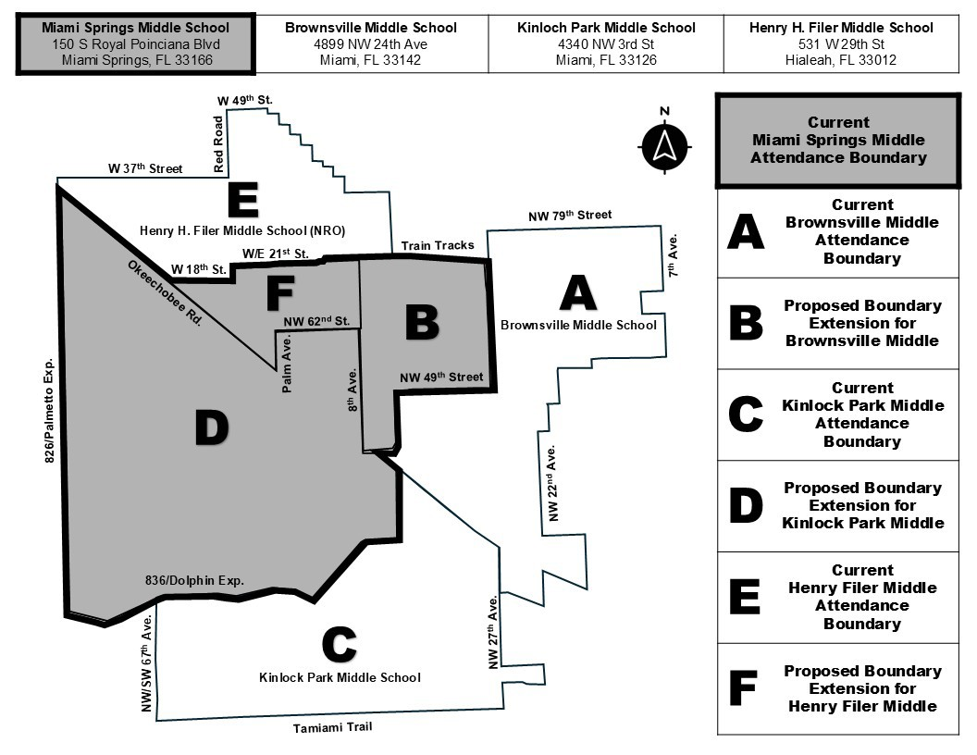
Recommended Boundaries

Slide 65
Current Boundary
Miami Springs Middle School
Begin at Palmetto Expressway (SR 826) and Okeechobee Canal
Southeast on Canal to W 18 Street, Hialeah
East to W 4 Avenue (NW 57 Avenue)
North to Florida East Coast Railroad
East to NW 27 Avenue
South to NW 49 Street
West to Seaboard Railroad
South to Airport Expressway (112)
West to Miami River
Southeast to Seaboard Railroad
South to Tamiami Canal
West and Southwest to Dolphin Expressway (SR836)
West to Palmetto Expressway (SR 826)
North to Okeechobee Canal,
point of beginning.
49

Slide 66
Current Boundary
Brownsville Middle School
Begin at NW 27 Avenue and NW 79 Street (SR934)
East to NW 7 Avenue
South to NW 67 Street
West to NW 10 Avenue
South to NW 62 Street
East to NW 7 Avenue (SR441)
South to NW 54 Street (SR944)
West to NW 15 Avenue
South to NW 52 Street
West to NW 19 Avenue
South to NW 46 Street
West to NW 21 Avenue
South to Airport Expressway (SR112)
West to NW 22 Avenue
South to NW 20 Street
East to NW 17 Avenue
South to Miami River
Northwest along Miami River to NW 22 Avenue
South to East-West Expressway (SR836)
Northwest to 27 Avenue
North to Miami River
Northwest along Miami River to Seaboard Railroad
North to NW 49 Street
East to NW 27 Avenue
North to NW 79 Street, point of beginning.
50

Slide 67
Current Boundary
Kinloch Park Middle School
Begin at SW 8 Street (SR41) and SW 67 Avenue
North to East-West Expressway (SR836)
East to Tamiami Canal
Northeast on Tamiami Canal to Seaboard Railroad
North on Seaboard RR to Miami River
Southeast on Miami River to NW 27 Avenue
South on 27 Avenue to W Flagler Street
East on W Flagler Street to NW 22 Avenue
South on NW 22 Avenue to SW 3 Street
West on SW 3 Street to NW 27 Avenue
South on NW 27 Avenue to SW 8 Street (SR41)
West on SW 8 Street (SR41), point of beginning.
51

Slide 68
Current Boundary
Henry H. Filer Middle School
Begin at West 49 Street and Palm Avenue
South to East 48 Street
East to East 1 Avenue
South to East 46 Street
East to East 2 Avenue
South to East 44 Street
East to East 3 Avenue
South to East 42 Street
East to East 4 Avenue
South to East 39 Street
East to East 5 Avenue
South to East 38 Street
East to East 6 Avenue
South to East 36 Street
East to East 7 Avenue
South to East 33 Street
East to Seaboard Railroad
South to East 21 Street (Florida East Coast Railroad)
West to West 4 Avenue (Red Road)
South to West 18 Street
West to Okeechobee Canal Northwest to Palmetto Expressway (SR 826)
North to West 37 Street
East to West 4 Avenue (Red Road)
North to West 49 Street
East to Palm Avenue, point of beginning.
52

Slide 69
Recommended Boundary
Proposed boundary for Brownsville Middle School
Begin at NW 27 Avenue and NW 79 Street (SR934)
East to NW 7 Avenue
South to NW 67 Street
West to NW 10 Avenue
South to NW 62 Street
East to NW 7 Avenue (SR441)
South to NW 54 Street (SR944)
West to NW 15 Avenue
South to NW 52 Street
West to NW 19 Avenue
South to NW 46 Street
West to NW 21 Avenue
South to Airport Expressway (SR112)
West to NW 22 Avenue
South to NW 20 Street
East to NW 17 Avenue
South to Miami River
Northwest along Miami River to NW 22 Avenue
South to East-West Expressway (SR836)
Northwest to 27 Avenue
North to Miami River
Northwest along Miami River to East 8 Avenue
North to the Railroad
East along the Railroad to NW 27 Avenue
North to NW 79 Street,
point of beginning.
55

Slide 70


Recommended Boundary
56

Slide 71

Recommended Boundary
Proposed boundary for Henry H. Filer Middle School
57

Slide 72
Effects
Beginning with the 2026 - 2027 School Year:
Combine Miami Springs Middle School and Miami Springs Senior High School as the first 6-12 Academy in the city of Miami Springs.
All rising 6th – 8th grade students currently in the Miami Springs Middle boundary may attend Brownsville Middle, Kinloch Park Middle, or Henry H. Filer Middle as their middle school option.
Research highlights the benefits of a smoother transition to high school, building strong and positive relationships, and earlier access to college and career readiness pathways.
Expanded academic and athletic opportunities for all students.
58
Notes:
Corrected the first bullet to reflect this being the first 6-12 in Miami Springs as suggested by the Superintendent.

Slide 73
Effects
Beginning with the 2026 - 2027 School Year:
Miami-Dade County Public Schools Attendance Boundary Committee (ABC) Capacity Membership Data
Miami Springs Senior High School
Capacity Membership | Current 2025-2026 | Projected 2026-2027 | Projected 2027-2028
Grade Configuration | High (9-12) | Prep Academy (6-12) | Prep Academy (6-12)
Student Enrollment | 1026 | 1591 | 1590
Perm FISH Cap | 2011 | 2011 | 2011
% Utilization Perm FISH Cap | 51.01% | 79.11% | 79.06%
Perm & Temp FISH Cap | 2011 | 2011 | 2011
% Utilization Perm & Temp | 51.01% | 79.11% | 79.06%
58
Notes:
Corrected the first bullet to reflect this being the first 6-12 in Miami Springs as suggested by the Superintendent.

Slide 74

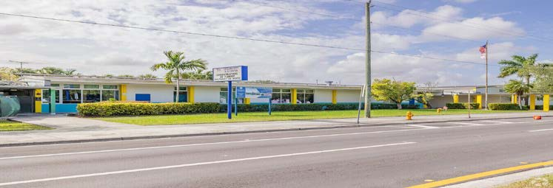
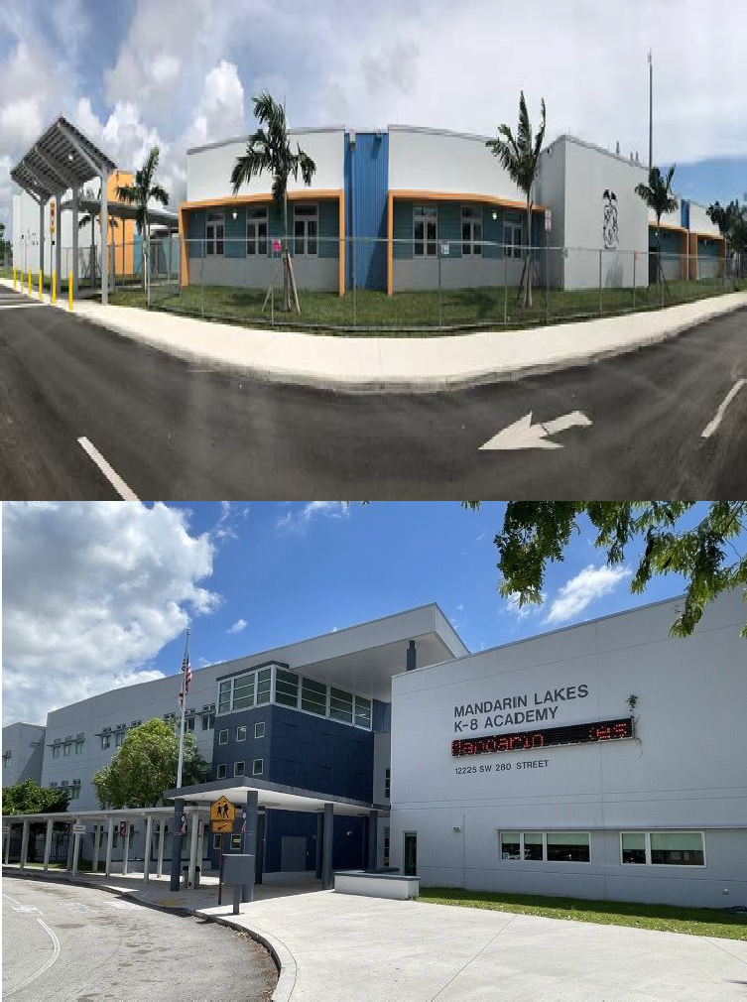
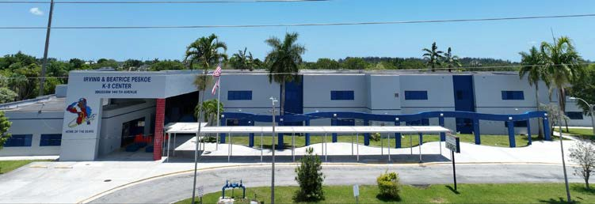
Proposed Attendance Boundary Recommendations
South Region Office
Air Base K-8 Center
Irving & Beatrice Peskoe K-8 Center
Leisure City K-8 Center Mandarin Lakes K-8 Center
Mr. Rafael A. Villalobos
Region Superintendent
Ms. Robin Y. Atkins
ABC Region Director

Slide 75
Impact
Due to declining enrollment and the ability to conduct a viable educational program, the following recommendations are proposed:
Dissolve the current boundary for Mandarin Lakes K-8 Academy.
Establish new boundaries for Leisure City K-8 and Irving & Beatrice Peskoe K-8 to include Mandarin Lakes boundary.
Increased enrollment access to Air Base K-8 Center.
Additional student seats to accommodate the community demand for the academic programs offered at Air Base K-8.
Efficient use of existing physical infrastructure at Mandarin Lakes K-8
60

Slide 76
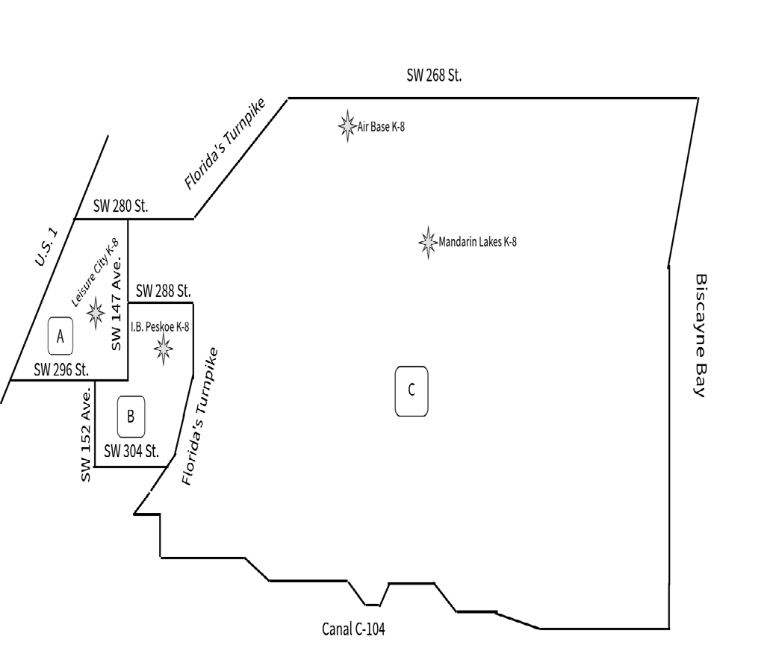
Current Boundaries
AREA | DESCRIPTION
A | Current boundary for Leisure City K-8
B | Current boundary for I.B. Peskoe K-8
C | Current boundary for Mandarin Lakes K-8
61

Slide 77
Mandarin Lakes K8 Center Boundary Analysis
School Name (Enrolled) |  |  |  |  | Count | %
Mandarin Lakes K-8 Center (0073) |  |  |  |  | 478 | 16.53%
Charter School At Waterstone (1010) |  |  |  |  | 333 | 11.52%
Keys Gate Charter School (3610) |  |  |  |  | 202 | 6.99%
Air Base K-8 Ctr Int'L Educ (0041) |  |  |  |  | 198 | 6.85%
Academir Charter Schl Math & S (4242) |  |  |  |  | 176 | 6.09%
Leisure City K-8 Center (2901) |  |  |  |  | 120 | 4.15%
Somerset Academy(Silver Palms) (0332) |  |  |  |  | 107 | 3.7%
Everglades Preparatory Academy (5006) |  |  |  |  | 105 | 3.63%
Irving & Beatrice Peskoe K-8 (4391) |  |  |  |  | 94 | 3.25%
Somerset Prep Acad Homestead (0754) |  |  |  |  | 69 | 2.39%
Academir Middle Math And Scien (2032) |  |  |  |  | 60 | 2.08%
Somerset Prep Acad Middle (6046) |  |  |  |  | 57 | 1.97%
Redland Middle (6761) |  |  |  |  | 53 | 1.83%
William A. Chapman Elementary (0771) |  |  |  |  | 42 | 1.45%
Somerset Acad Silver Palms @ P (4012) |  |  |  |  | 40 | 1.38%
A total of 2,891 students, in grades K thru 8 live within Mandarin K- 8's boundary.

Slide 78
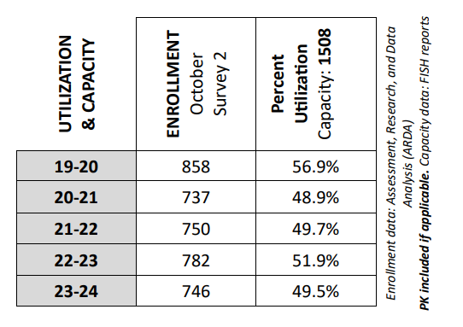
Mandarin Lakes K-8 Enrollment Trend Analysis
Grade Level Counts
GRADE LEVEL | 2024-2025* (8/26/24) | 2025-2026** (3/30/26)
K | 53 | 59
1 | 49 | 58
2 | 52 | 53
3 | 79 | 72
4 | 68 | 54
5 | 76 | 61
6 | 76 | 66
7 | 70 | 63
8 | 82 | 57
TOTAL | 605 | 543
Exiting Cohort | 82 | -23
Incoming Cohort | 59
*2024-25 grade level enrollment data from FASCO
** 2025-26 grade level enrollment data from Product W2390E01

Slide 79
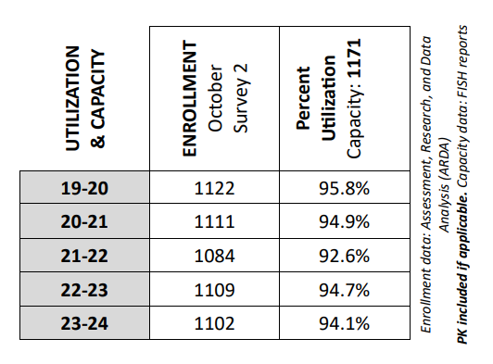
Air Base K-8 Enrollment Trend Analysis
Grade Level Counts
GRADE LEVEL | 2024-2025* (8/26/24) | 2025-2026** (3/30/26)
K | 117 | 114
1 | 124 | 125
2 | 119 | 118
3 | 112 | 118
4 | 127 | 129
5 | 116 | 125
6 | 130 | 114
7 | 107 | 116
8 | 113 | 105
TOTAL | 1065 | 1064
Exiting Cohort | 113 | 1
Incoming Cohort | 114
*2024-25 grade level enrollment data from FASCO
** 2025-26 grade level enrollment data from Product W2390E01

Slide 80
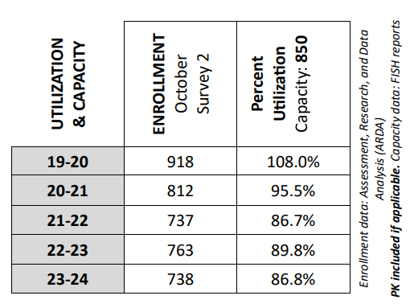
Irving & Beatrice Peskoe K-8 Enrollment Trend Analysis
Grade Level Counts
GRADE LEVEL | 2024-2025* (8/26/24) | 2025-2026** (3/30/26)
K | 52 | 59
1 | 62 | 56
2 | 76 | 66
3 | 99 | 85
4 | 79 | 83
5 | 97 | 87
6 | 82 | 86
7 | 70 | 78
8 | 83 | 63
TOTAL | 700 | 663
Exiting Cohort | 83 | -24
Incoming Cohort | 59
*2024-25 grade level enrollment data from FASCO
** 2025-26 grade level enrollment data from Product W2390E01

Slide 81
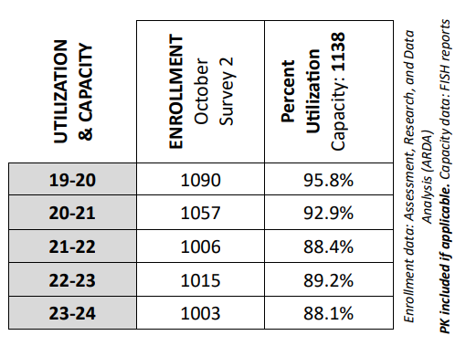
Leisure City K-8 Enrollment Trend Analysis
Grade Level Counts
GRADE LEVEL | 2024-2025* (8/26/24) | 2025-2026** (3/30/26)
K | 104 | 103
1 | 101 | 119
2 | 104 | 94
3 | 120 | 117
4 | 94 | 111
5 | 113 | 98
6 | 106 | 106
7 | 94 | 97
8 | 108 | 88
TOTAL | 944 | 933
Exiting Cohort | 108 | -5
Incoming Cohort | 103
*2024-25 grade level enrollment data from FASCO
** 2025-26 grade level enrollment data from Product W2390E01

Slide 82
Current Boundaries
Air Base K-8 Center
As a completely magnet school, it does not have attendance boundaries.
Assigned current boundary for Leisure City K-8 Center
Begin at SW 280 Street & U.S. 1
East to SW 147 Avenue
South to SW 296 Street
West to U.S. 1
North to SW 280 Street, point of beginning

Slide 83
Current Boundaries
Assigned current boundaries for Mandarin Lakes K-8 Center
Begin at Florida's Turnpike and SW 268 Street
East to Biscayne Bay
South along coast to Canal C-103
West along Canal C-103 to SW 152 Avenue
North to Campbell Drive
West to Florida's Turnpike
North to SW 288 Street
West to SW 147 Avenue
North to SW 280 Street
East to Florida's Turnpike, point of beginning

Slide 84
Current Boundaries
Assigned current boundaries for Irving & Beatrice Peskoe K-8 Center
Begin at SW 147 Avenue & SW 288 Street
East to Florida's Turnpike
South to SW 304 Street
West to SW 152 Avenue
North to SW 296 Street
East to SW 147 Avenue
North to SW 288 Street, point of beginning.

Slide 85
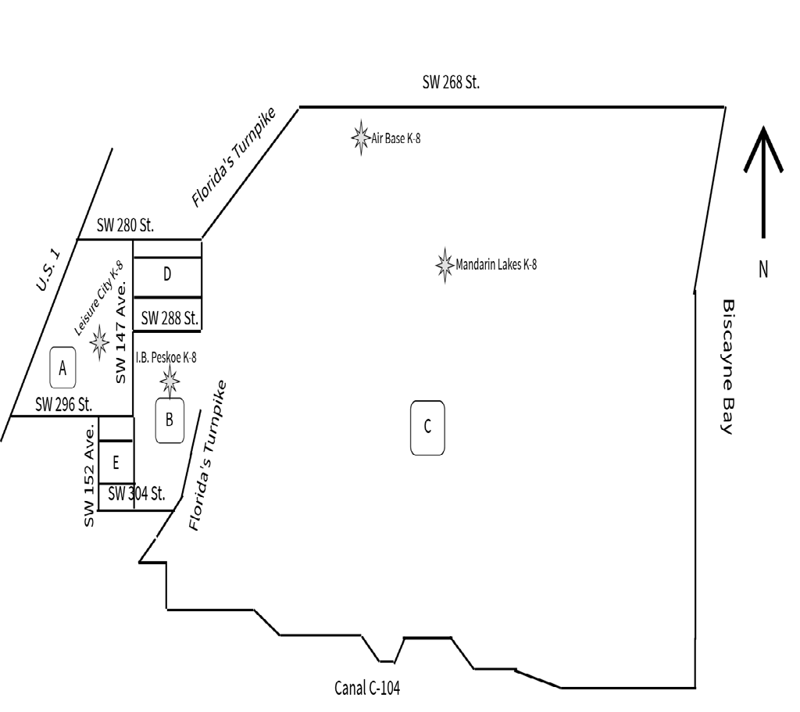
Recommended Boundary
AREA | DESCRIPTION
A D E | Proposed new boundary for Leisure City K-8 incorporating Area D reassigned from Mandarin Lakes to Leisure City K-8 and rea E reassigned from I.B. Peskoe K-8 to Leisure City K-8
B C | Proposed: New boundary for I.B. Peskoe K-8 combines its remaining boundary with the area currently assigned to Mandarin Lakes K-8
66

Slide 86
Recommended Boundaries
Proposed boundary for Areas A, D, & E
Schools Impacted: Leisure City K-8, I & B Peskoe K-8, & Mandarin Lakes K-8
Begin at U.S. 1 and SW 280 Street
East to Florida's Turnpike
South to SW 288 Street
West to 147 Avenue
South to SW 304 Street
West to SW 152 Avenue
North to SW 296 Street
West to U.S. 1
North to SW 280 Street, point of beginning.

Slide 87
Recommended Boundaries
Proposed Boundary for Areas B & C
Schools Impacted: I & B Peskoe K-8 and Mandarin Lakes K-8
Begin SW 304 Street and SW 147 Avenue
North, along the Florida's Turnpike to SW 288 Street
East to the Florida's Turnpike
South, along the Florida's Turnpike to Campbell Drive
East to SW 152 Avenue
East along Canal C-103 to Biscayne Bay
North to SW 268 Street
West to Florida's Turnpike
South to SW 288 Street
West to SW 147 Avenue
South to SW 304 Street,
point of beginning.

Slide 88

Effects
Establish new boundaries for Leisure City K-8 and Irving & Beatrice Peskoe K-8 to include Mandarin Lakes boundary.
Beginning in the 2026-2027 school year, all Mandarin Lakes K8 students will transition to either Leisure City K-8 or I & B Peskoe K-8 according to the proposed boundary changes.
Beginning with the 2026-2027 school year, all Air Base K8 students will relocate to the current Mandarin Lakes K-8 facility.
Efficient use of existing physical infrastructure at Mandarin Lakes K-8
69

Slide 89
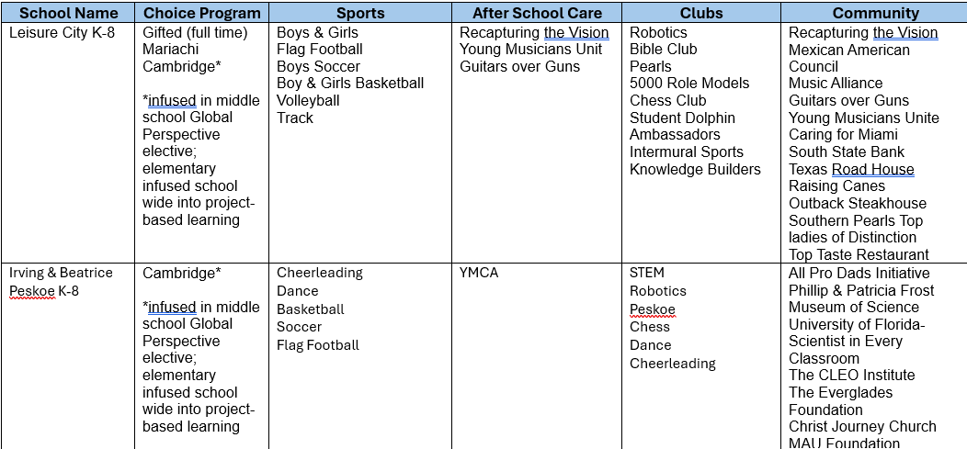
Effects
ACADEMIC AND EXTRA CURRICULAR OFFERINGS
69

Slide 90
Effects
Air Base K-8 Center
Capacity Membership | Current 2025-2026 | Projected 2026-2027 | Projected 2027-2028
Grade Configuration | K-8 | K-8 | K-8
Student Enrollment | 1,135 | 1,473* | 1,471*
Perm FISH Cap | 1,171 | 1,508 | 1,508
% Utilization Perm FISH Cap | 96.92% | 97.6% | 97.5%
Perm & Temp FISH Cap | 1,268 | 1,508 | 1,508
% Utilization Perm & Temp | 89.51% | 97.6% | 97.5%
*300 additional student stations will be created by the move of Air Base K-8 Center to the building currently housing Mandarin Lakes K-8.
69

Slide 91
Effects
Leisure City K-8
Capacity Membership | Current 2025-2026 | Projected 2026-2027 | Projected 2027-2028
Grade Configuration | K-8 | K-8 | K-8
Student Enrollment | 1,037 | 1036 | 1044
Perm FISH Cap | 1,138 | 1,138 | 1,138
% Utilization Perm FISH Cap | 91.12% | 91.03% | 91.73%
Perm & Temp FISH Cap | 1,138 | 1,138 | 1,138
% Utilization Perm & Temp | 91.12% | 91.03% | 91.73%
69

Slide 92
Effects
Irving & Beatrice Peskoe K-8 Center
Capacity Membership | Current 2025-2026 | Projected 2026-2027 | Projected 2027-2028
Grade Configuration | K-8 | K-8 | K-8
Student Enrollment | 681 | 1046 | 1009
Perm FISH Cap | 850 | 850 | 850
% Utilization Perm FISH Cap | 80.11% | 123% | 118%
Perm & Temp FISH Cap | 866 | 866 | 866
% Utilization Perm & Temp | 78.63% | 120% | 117%
69

Slide 93

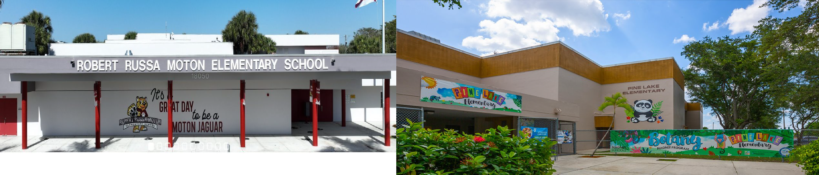
Proposed Attendance Boundary Recommendations
South Region Office
Robert Russa Moton Elementary Pine Lake Elementary
Mr. Rafael A. Villalobos
Region Superintendent
Ms. Robin Y. Atkins
ABC Region Director

Slide 94
Impact
Due to declining enrollment and the ability to conduct a viable educational program, the following recommendations are proposed:
Dissolve the current boundary for Robert Russa Elementary School.
Establish new boundaries for Robert Russa Elementary School.
Combine the boundaries of Robert Russa Elementary School and Pine Lake Elementary School.
71

Slide 95
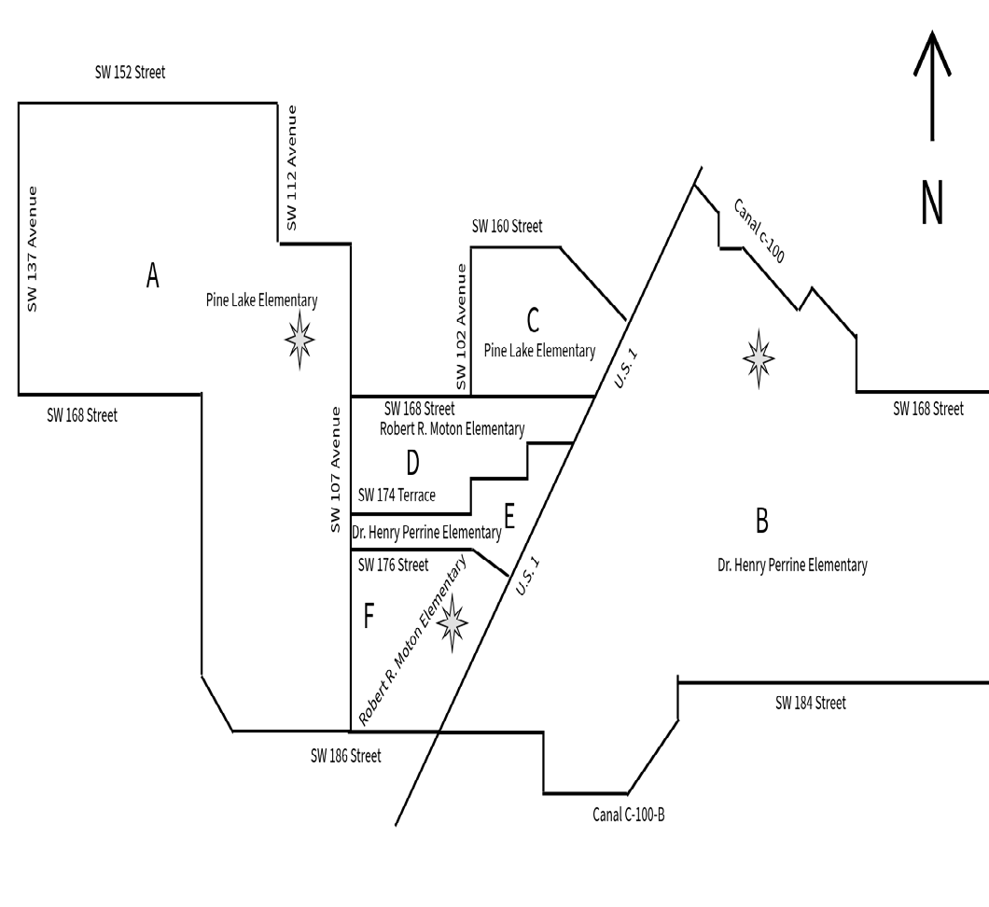
Current Boundaries
AREA | Description
A | Assigned boundary for Pine Lake E.S.
B | Assigned boundary for Dr. Henry Perrine E.S.
C | Assigned boundary for Pine Lake E.S.
D | Assigned boundary for Robert R. Moton E.S.
E | Assigned boundary for Dr. Henry Perrine E.S.
F | Assigned boundary for Robert R. Moton E.S.
72

Slide 96
Current Boundaries
School Name (Enrolled) | Count | %
Robert Russa Moton Elementary (3541) | 103 | 32.59%
Dr Henry E Perrine Academy (4381) | 31 | 9.81%
Pine Lake Elementary (4441) | 28 | 8.86%
Johnnie M Parris Colonial Dr. (0861) | 16 | 5.06%
Frank C. Martin K-8 Center (3101) | 13 | 4.11%
Gulfstream Elementary (2321) | 13 | 4.11%
Gloria Floyd Elementary (2021) | 9 | 2.85%
Academir Charter School Prep (1015) | 8 | 2.53%
Bel-Aire Elementary (0261) | 8 | 2.53%
Whispering Pines Elementary (5951) | 7 | 2.22%
Currently, there are 316 students in grades K-5 that live within Robert Russa Moton Elementary's boundary. These are their top destinations.
73

Slide 97
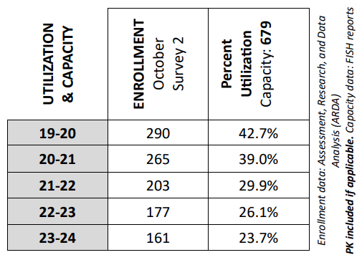
Robert Russa Moton E.S. Enrollment Trend Analysis
Grade Level Counts
GRADE LEVEL | 2024-2025* (8/26/24) | 2025-2026** (3/30/26)
K | 28 | 26
1 | 25 | 27
2 | 25 | 18
3 | 27 | 15
4 | 23 | 20
5 | 27 | 15
TOTAL | 155 | 121
Exiting Cohort | 27 | -1
Incoming Cohort | 26
*2024-25 grade level enrollment data from FASCO
** 2025-26 grade level enrollment data from Product W2390E01

Slide 98
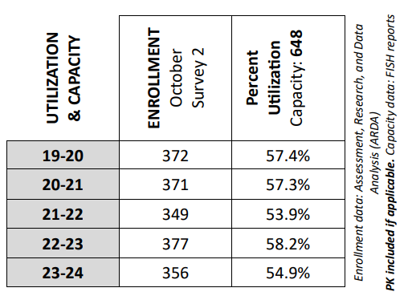
Pine Lake E.S. Enrollment Trend Analysis
Grade Level Counts
GRADE LEVEL | 2024-2025* (8/26/24) | 2025-2026** (3/30/26)
K | 39 | 33
1 | 31 | 28
2 | 45 | 21
3 | 49 | 41
4 | 41 | 44
5 | 59 | 48
TOTAL | 264 | 215
Exiting Cohort | 59 | -26
Incoming Cohort | 33
*2024-25 grade level enrollment data from FASCO
** 2025-26 grade level enrollment data from Product W2390E01

Slide 99
Current Boundaries
Assigned current boundary for Pine Lake Elementary
Begin at SW 152 Street& SW 137 Avenue
East to SW 112 Avenue
South to SW 160 Street
East to SW 107 Avenue
South to SW 186 Street
West to Florida's Turnpike
North to SW 168 Street
West to SW 137 Avenue
North to SW 152 Street
Eastern Satellite Boundary
Begin at SW 168 Street and SW 102 Avenue
North to SW 160 Street
East to U.S. 1
South to SW 168 Street
West to SW 102 Avenue
North to SW 160 Street, point of beginning.

Slide 100
Current Boundaries
Assigned current boundary for Dr. Henry Perrine Elementary
Begin at U.S. 1 and Canal C-100
Southeast to SW 168 Street
East to Biscayne Bay
South to SW 184 Street
West to Canal C-100-B
West to SW 97 Avenue
North to SW 186 Street
West to U.S. 1
North to Hibiscus Street
West to SW 176 Street
West to SW 107 Avenue
North to SW 174 Terrace
East to SW 102 Avenue
North to SW 172 Street
East to 99 Court
North to SW 170 Street
East to U.S. 1
North to Canal C-100, point of beginning.

Slide 101
Current Boundaries
Assigned current boundary for Robert Russa Moton Elementary
Northern boundary begins at SW 168 St & SW 107 Avenue
East to U.S. 1
South to SW 170 Street
West to SW 99 Court
South to SW 172 Street
West to SW 102 Avenue
South to SW 174 Terrace
West to SW 107 Avenue
North to SW 168 Street
End Northern boundary
Southern boundary begins at SW 176 Street & SW 107 Avenue
East to Hibiscus Street
East to U.S. 1
South to SW 186 Street
West to SW 107 Avenue
North to SW 176 Street
End Southern boundary

Slide 102
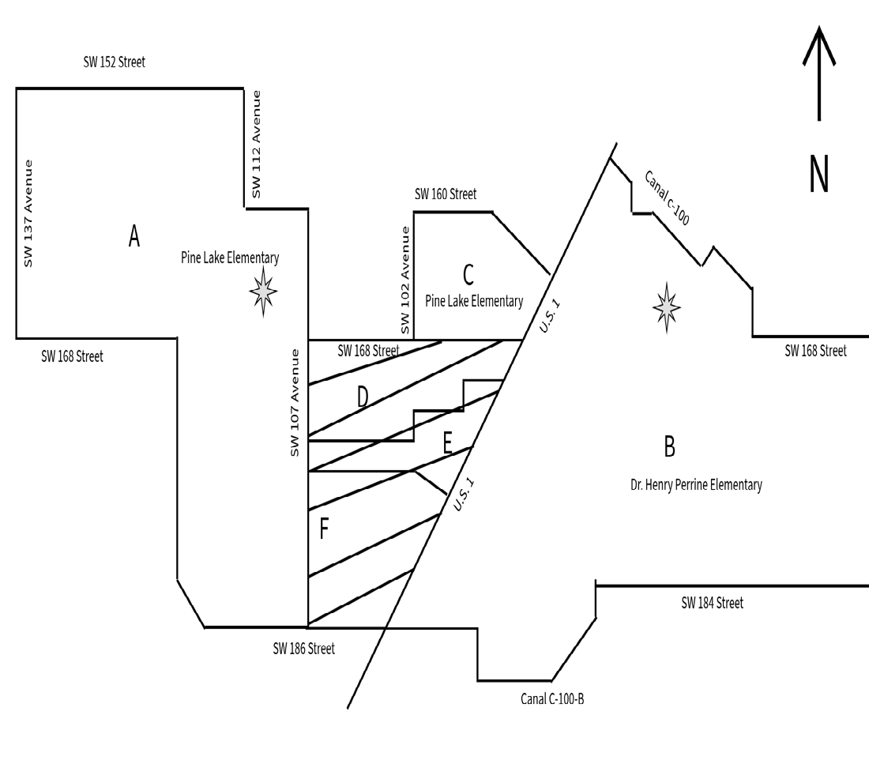
Recommended Boundary
Area | Description
A C D E F | Proposed boundary: R.R. Moton's boundaries (areas D & F) would be reassigned to Pine Lake Elementary. Furthermore, area E, currently assigned to Dr. Henry Perrine would be reassigned to Pine Lake Elementary. This would create one unified boundary.
B | Dr. Henry Perrine Elementary's boundary would remain completely east of U.S. 1. Area E would be reassigned to Pine Lake Elementary.
77

Slide 103
Recommended Boundaries
Proposed boundary for Pine Lake Elementary
Begin at SW 152 Street & SW 137 Avenue.
East to SW 112 Avenue
South to SW 160 Street
East to SW 107 Avenue
South to SW 168 Street
East to SW 102 Avenue
North to SW 160 Street
East to U.S. 1
South to SW 186 Street
West to Florida's Turnpike
North to SW 168 Street
West to SW 137 Avenue
North to SW 152 Street, point of beginning.
78

Slide 104
Recommended Boundaries
Proposed boundary for Dr. Henry Perrine Elementary
Begin at U.S. 1 and Canal C-100
Southeast to SW 168 Street
East to Biscayne Bay
South to SW 184 Street
West to Canal C-100-B
West to SW 97 Avenue
North to SW 186 Street
West to U.S. 1
North to Canal C-100, point of beginning.
79

Slide 105

Effects
Beginning with the 2026-2027 School Year:
New boundaries will be established for Pine Lake Elementary School to include R.R. Moton Elementary School's boundary.
Combine the boundaries of Pine Lake Elementary and R.R. Moton Elementary School.
Establish new boundaries for Henry Perrine Elementary School.
Dissolving R.R. Moton's boundaries, will increase student access to more robust academic programs and resources.
An existing portion of Dr. Henry Perrine Elementary's boundary, west of U.S. 1, that splits R.R. Moton Elementary's current boundary, would be dissolved and future students would attend Pine Lake Elementary.
Current Perrine students living within the proposed boundary changes can choose to remain at Dr. Henry Perrine.
80

Slide 106
Effects ACADEMIC AND EXTRA CURRICULAR OFFERINGS
School Name | Choice/Magnet Program | After School Care | Clubs | Community
Pine Lake | Cambridge (Choice) and Zoo/Botany Magnet | YMCA Afterschool Care Girls Inc | Critter Club Robotics STEM Safety Patrol Wellness Cheerleading* *beginning with the 26-27 school year | Zoo Miami/Fairchild Tropical Gardens Partnership with Richmond Heights/BioTech
Pine Lake Elementary School has a PLC which provides United Way, Head Start and VPK childcare available from 2 months to 4 years old.
80

Slide 107
Effects
Pine Lake Elementary
Capacity Membership | Current 2025-2026 | Projected 2026-2027 | Projected 2027-2028
Grade Configuration | K-5 | K-5 | K-5
Student Enrollment | 280 | 325 | 316
Perm FISH Cap | 648 | 648 | 648
% Utilization Perm FISH Cap | 43.20% | 50% | 48%
Perm & Temp FISH Cap | 648 | 648 | 648
% Utilization Perm & Temp | 43.20% | 50% | 48%
80

Slide 108
Effects
Dr. Henry E. Perrine Academy of the Arts
Capacity Membership | Current 2025-2026 | Projected 2026-2027 | Projected 2027-2028
Grade Configuration | K-5 | K-5 | K-5
Student Enrollment | 472 | 416 | 380
Perm FISH Cap | 840 | 840 | 840
% Utilization Perm FISH Cap | 56.19% | 49% | 45%
Perm & Temp FISH Cap | 840 | 840 | 840
% Utilization Perm & Temp | 56.19% | 49% | 45%
80

Slide 109
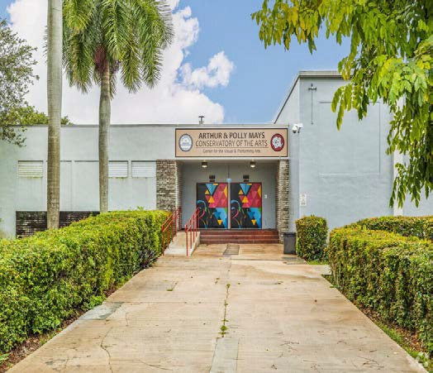
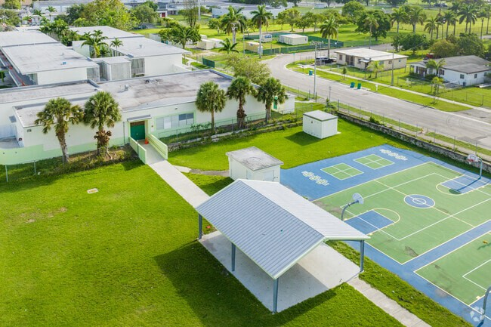

Proposed Attendance Boundary Recommendations
South Region Office
Arthur & Polly Mays Conservatory of the Arts 6-12 & Pine Villa Elementary
Mr. Rafael A. Villalobos
Region Superintendent
Ms. Robin Y. Atkins
ABC Region Director

Slide 110
Impact
Due to declining student enrollment at Pine Villa Elementary School, Arthur & Polly Mays Conservatory of the Arts and Pine Villa Elementary School will merge to create a K-12 experience for students.
82

Slide 111
Current Boundaries
• Arthur & Polly Mays 6-12 does not have a boundary.
• Current boundary for Pine Villa Elementary:
Begin at U.S. 1 & Black Creek Canal
• East to SW 112 Avenue
• South to SW 232 Street
• West to U.S. 1
• North to Black Creek Canal point of beginning.

Slide 112
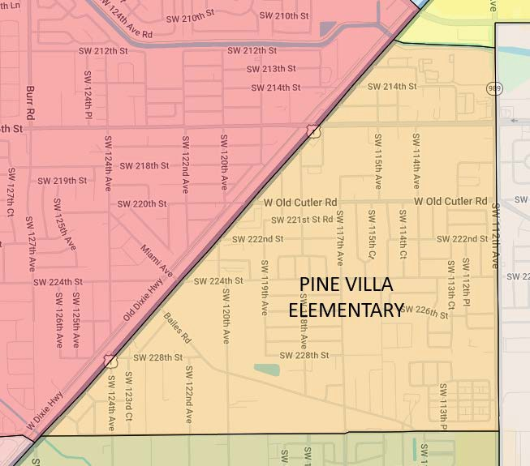
Current Boundaries
Current boundary for Pine Villa Elementary:

Slide 113
Pine Villa Elementary School Boundary Analysis
School Name (Enrolled) | Count | %
Pine Villa Elementary (4461) | 93 | 23.85%
Somerset Academy(Silver Palms) (0332) | 61 | 15.64%
Coral Reef Montessori Acad Ch (0070) | 24 | 6.15%
Goulds Elementary (0311) | 23 | 5.9%
Somerset Academy Silver Palms @ P (4012) | 19 | 4.87%
Academir Charter School Prep (1015) | 17 | 4.36%
Gulfstream Elementary (2321) | 15 | 3.85%
Summerville Advantage Academy (0072) | 12 | 3.08%
Caribbean K-8 Center (0661) | 10 | 2.56%
South Point Scholars Academy (5836) | 10 | 2.56%
Mater Academy Bay Elementary (4010) | 9 | 2.31%
Currently, 390 students in grades K-5 live within Pine Villa Elementary's boundaries. These are their top destinations.

Slide 114
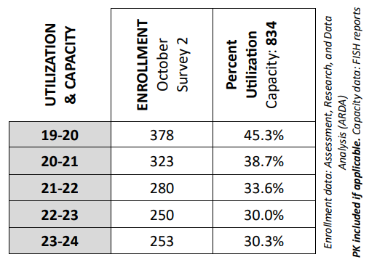
Pine Villa E.S. Enrollment Trend Analysis
Grade Level Counts
GRADE LEVEL | 2024-2025* (8/26/24) | 2025-2026** (3/30/26)
K | 17 | 14
1 | 20 | 16
2 | 21 | 30
3 | 28 | 16
4 | 26 | 31
5 | 22 | 27
TOTAL | 134 | 134
Exiting Cohort | 22
Incoming Cohort | 14 | -8
*2024-25 grade level enrollment data from FASCO
** 2025-26 grade level enrollment data from Product W2390E01

Slide 115

Arthur & Poly Mays 6-12 Enrollment Trend Analysis
Grade Level Counts
GRADE LEVEL | 2024-2025* (8/26/24) | 2025-2026** (3/30/26)
6 | 108 | 66
7 | 99 | 93
8 | 76 | 79
9 | 54 | 44
10 | 62 | 42
11 | 59 | 49
12 | 58 | 51
TOTAL | 516 | 424
Exiting Cohort | 58 | 8
Incoming Cohort | 66
*2024-25 grade level enrollment data from FASCO
** 2025-26 grade level enrollment data from Product W2390E01

Slide 116
Recommended Boundaries
Students in grades K-5 living within the current Pine Villa Elementary School boundary can continue to attend Arthur and Polly Mays Conservatory of the Arts K-12 Lower Academy
86

Slide 117
Effects
Beginning with the 2026-2027 School Year:
Combine Arthur & Polly Mays Conservatory of the Arts and Pine Villa Elementary School to create Arthur & Polly Mays Conservatory of the Arts K-12 Upper and Lower Academy.
Students will explore the various areas of the arts before declaring their interest at the secondary level.
87

Slide 118
Effects
Arthur and Polly Mays Conservatory of the Arts
Capacity Membership | Current 2025-2026 | Projected 2026-2027 | Projected 2027-2028
Grade Configuration | 6-12 | K-12 | K-12
Student Enrollment | 430 | 444 | 461
Perm FISH Cap | 985 | 985 | 985
% Utilization Perm FISH Cap | 43.65% | 45% | 46%
Perm & Temp FISH Cap | 985 | 985 | 985
% Utilization Perm & Temp | 43.65% | 45% | 46%
87

Slide 119
Effects
Pine Villa Elementary
Capacity Membership | Current 2025-2026 | Projected 2026-2027 | Projected 2027-2028
Grade Configuration | K-5 | K-12 | K-12
Student Enrollment | 240 (135 K-5) | 121 | 103
Perm FISH Cap | 834 | 834 | 834
% Utilization Perm FISH Cap | 28.77% (16%) | 15% | 12%
Perm & Temp FISH Cap | 834 | 834 | 834
% Utilization Perm & Temp | 28.77%
87

Slide 120



Proposed Attendance Boundary Recommendations
South Region Office
Richmond Heights Middle & BioTech 9-12
Mr. Rafael A. Villalobos
Region Superintendent
Ms. Robin Y. Atkins
ABC Region Director

Slide 121
Impact
Due to declining student enrollment at Richmond Heights Middle School, BioTech and Richmond Heights Middle School will merge to create a 6-12 experience for students.
89

Slide 122

Current Boundaries
Current boundary for Richmond Heights Middle:

Slide 123
Richmond Heights Middle School Boundary Analysis
School Name (Enrolled) | Count | %
Richmond Heights Middle (6781) | 203 | 16.05%
Herbert A. Ammons Middle (6001) | 116 | 9.17%
Arvida Middle School (6021) | 105 | 8.3%
Somerset Academy Middle (6004) | 100 | 7.91%
Southwood Middle (6861) | 74 | 5.85%
Jorge Mas Canosa Middle (6771) | 69 | 5.45%
Bridgeprep Academy Village Gre (3036) | 66 | 5.22%
Devon Aire K-8 Center (1331) | 65 | 5.14%
Frank C. Martin K-8 Center (3101) | 51 | 4.03%
Palmetto Middle (6701) | 41 | 3.24%
Currently 1,265 students in grades 6-8 live within Richmond Heights Middle's boundaries. These are their top destinations.

Slide 124

Richmond Heights M.S. Enrollment Trend Analysis
Grade Level Counts
GRADE LEVEL | 2024-2025* (8/26/24) | 2025-2026** (3/30/26)
6 | 109 | 77
7 | 107 | 106
8 | 129 | 86
TOTAL | 345 | 269
Exiting Cohort | 129 | -52
Incoming Cohort | 77
*2024-25 grade level enrollment data from FASCO
** 2025-26 grade level enrollment data from Product W2390E01

Slide 125

Bio Tech SHS Enrollment Trend Analysis
Grade Level Counts
GRADE LEVEL | 2024-2025* (8/26/24) | 2025-2026** (3/30/26)
9 | 72 | 56
10 | 88 | 79
11 | 72 | 85
12 | 64 | 68
TOTAL | 296 | 288
Exiting Cohort | 64 | -8
Incoming Cohort | 56
*2024-25 grade level enrollment data from FASCO
** 2025-26 grade level enrollment data from Product W2390E01

Slide 126
Current Boundaries
Bio Tech 9-12 does not have attendance boundaries. Current boundary for Richmond Heights Middle: Begin at SW 137 Avenue & SW 120 Street
East to Canal C-100
Follow Canal C-100 south towards SW 117 Avenue
South to SW 152 Street
East to Harrison Street
North to Graves Street
Northeast to Polk Street
North, then east, then north to the west of SW 110 Avenue to Canal C-100
Follow Canal C-100 Southeast to U.S. 1
South to SW 160 Street
West to SW 99 Avenue

Slide 127
Current Boundaries (cont.)
Bio Tech 6-12 does not have attendance boundaries. Current boundary for Richmond Heights Middle:
South to between SW 164 Terrace and SW 165 Terrace
East to SW 101 Avenue
North to SW 163 Street
West to SW 102 Avenue
South to SW 164 Street
West to SW 107 Avenue
South to SW 184 Street
West to SW 137 Avenue
North to SW 120 Street, point of beginning.

Slide 128
Recommended Boundaries
Students in grades 6-8 living within the current Richmond Heights Middle School boundary can continue to attend BioTech @ Richmond Heights 6-12 School.
94

Slide 129
Effects
Richmond Heights Middle and BioTech will merge to become BioTech @ Richmond Heights 6-12 School.
Strengthen School Resources and enhance academic programs.
Provide students access to hands on field experiences, as well as environmental partners.
Middle school students will have the opportunity to experience the various areas of conservation biology.
95

Slide 130

Effects EXTRA CURRICULAR OFFERINGS
95

Slide 131
Effects
Richmond Heights Middle
Capacity Membership | Current 2025-2026 | Projected 2026-2027 | Projected 2027-2028
Grade Configuration | 6-8 | 6-12 | 6-12
Student Enrollment | 270 | 260 | 228
Perm FISH Cap | 914 | 914 | 914
% Utilization Perm FISH Cap | 29.54% | 28% | 25%
Perm & Temp FISH Cap | 973 | 973 | 973
% Utilization Perm & Temp | 27.74% | 26% | 23%
95

Slide 132
Effects
Biotech @ Richmond Heights 9-12 Senior High
Capacity Membership | Current 2025-2026 | Projected 2026-2027 | Projected 2027-2028
Grade Configuration | 9-12 | 6-12 | 6-12
Student Enrollment | 290 | 278 | 249
Perm FISH Cap | 219 | 219 | 219
% Utilization Perm FISH Cap | 132.42% | 126% | 113%
Perm & Temp FISH Cap | 345 | 345 | 345
% Utilization Perm & Temp | 84.05% | 80.5% | 72%
95

Slide 133



Proposed Attendance Boundary Recommendations
South Region Office
Miami Southridge Senior High School South Dade Senior High School
Mr. Rafael A. Villalobos
Region Superintendent
Ms. Robin Y. Atkins
ABC Region Director

Slide 134
Impact
Decrease overcrowding occurring at South Dade Senior High School.
97

Slide 135

Current Boundaries
Assigned current boundary for Miami Southridge Senior High

Slide 136
Miami Southridge Senior High Boundary Analysis
School Name (Enrolled) | Count | %
Miami Southridge Senior High (7731) | 1639 | 25.74%
Coral Reef Senior High (7101) | 985 | 15.47%
Robert Morgan Educational Ctr (7371) | 560 | 8.8%
Miami Palmetto Senior High (7431) | 447 | 7.02%
Cutler Bay Senior High (6081) | 339 | 5.32%
Mater Academy Bay High School (7120) | 253 | 3.97%
Somerset College Prep Acad So. (7078) | 250 | 3.93%
John A Ferguson Senior High (7121) | 242 | 3.8%
Somerset Academy Charter High (7042) | 213 | 3.35%
Felix Varela Senior High (7781) | 176 | 2.76%
Currently there are 6,367 students in grades 9-12 that live within Miami Southridge Senior's boundaries. These are their top destinations.

Slide 137

South Dade SHS Enrollment Trend Analysis
Grade Level Counts
GRADE LEVEL | 2024-2025* (8/26/24) | 2025-2026** (3/30/26)
9 | 836 | 932
10 | 942 | 901
11 | 827 | 857
12 | 755 | 745
TOTAL | 3,360 | 3435
Exiting Cohort | 755 | 177
Incoming Cohort | 932
*2024-25 grade level enrollment data from FASCO
** 2025-26 grade level enrollment data from Product W2390E01

Slide 138

Southridge SHS Enrollment Trend Analysis
Grade Level Counts
GRADE LEVEL | 2024-2025* (8/26/24) | 2025-2026** (3/30/26)
9 | 505 | 511
10 | 635 | 503
11 | 601 | 510
12 | 493 | 544
TOTAL | 2,234 | 2068
Exiting Cohort | 493 | 18
Incoming Cohort | 511
*2024-25 grade level enrollment data from FASCO
** 2025-26 grade level enrollment data from Product W2390E01

Slide 139

Current Boundaries
Begin at SW 177 Avenue & SW 120 Street
East to SW 157 Avenue
South to SW 152 Street
East to CSX Railroad
Northeast along CSX railroad to Florida's Turnpike
South to SW 160 Street
East to SW 99 Avenue
South to SW 164 Terrace
West to SW 101 Avenue
North to SW 163 Street
West to SW 102 Avenue
South to SW 164 Street
West to SW 104 Avenue
North to SW 164 Street
West to SW 107 Avenue
South to SW 186 Street
East to U.S. 1
North to SW 184 Street
East to Biscayne Bay
South to SW 232 Street
West to SW 134 Avenue
North to SW 208 Street
East to SW 127 Avenue
North to SW 200 Street
West to SW 132 Avenue
North to Black Creek Canal
Northwest to approx. SW 195 Street
West to SW 137 Avenue
North to SW 168 Street
West to SW 177 Avenue
North to SW 120 Street,
point of beginning

Slide 140

Recommended Boundaries
101

Slide 141
Recommended Boundary
• Begin at SW 177 Avenue & SW 120 Street
East to SW 157 Avenue
South to SW 152 treet
East to CSX Railroad
Northeast along CSX railroad to Florida's Turnpike
South to SW 160 Street
East to SW 99 Avenue
South to SW 164 Terrace
West to SW 101 Avenue
North to SW 163 Street
West to SW 102 Avenue
South to SW 164 Street
West to SW 104 Avenue
North to SW 164 Street
West to SW 107 Avenue
South to SW 186 Street
East to U.S. 1
North to SW 184 Street
East to Biscayne Bay
South to SW 232 Street
West to SW 134 Avenue
North to SW 208 Street
East to SW 127 Avenue
North to SW 200 Street
West to SW 132 Avenue
North to Black Creek Canal
Northwest to approx. SW 195 Street
West to SW 137 Avenue
North to SW 168 Street
West to the Florida Everglades
North to approximately SW 136 Street
East to SW 177 Avenue
North to SW 120 Street,
point of beginning
102

Slide 142
Effects
Beginning with the 2026-2027 School Year:
Decrease overcrowding occurring at South Dade Senior High School.
103

Slide 143
Effects
South Dade SHS
Capacity Membership | Current 2025-2026 | Projected 2026-2027 | Projected 2027-2028
Grade Configuration | 9-12 | 9-12 | 9-12
Student Enrollment | 3,482 | 3,642 | 3,720
Perm FISH Cap | 3,302 | 3,302 | 3,302
% Utilization Perm FISH Cap | 105.45% | 110% | 112%
Perm & Temp FISH Cap | 3,302 | 3,302 | 3,302
% Utilization Perm & Temp | 105.45% | 110% | 112%
87

Slide 144
Effects
Southridge SHS
Capacity Membership | Current 2025-2026 | Projected 2026-2027 | Projected 2027-2028
Grade Configuration | 9-12 | 9-12 | 9-12
Student Enrollment | 2101 | 2066 | 2075
Perm FISH Cap | 2452 | 2452 | 2452
% Utilization Perm FISH Cap | 85.68% | 84% | 84.62%
Perm & Temp FISH Cap | 2452 | 2452 | 2452
% Utilization Perm & Temp | 85.68% | 84% | 84.62%
87

Slide 145

104

Slide 146



105

Slide 147


106

